Slide 1

UNIT 3

Slide 2
Unit-3 Teaching Hours: 10
Data link Layer
Chapter 10 Error detection and correction: Introduction – Checksum.
Chapter 12 Multiple Access: Random access (ALOHA, CSMA, CSMA/CD and CSMA/CA.)– Controlled Access: Reservation – Polling – Token Passing. Channelization: FDMA - TDMA.
Chapter 14 Wireless Lans: IEEE 802.11 - Architecture – MAC sub layer - Addressing Mechanism – Physical layer - BLUETOOTH : Architecture – Bluetooth layers.
Chapter 15 Connecting LANs, Backbone Networks, and Virtual LANs: CONNECTING DEVICES – Hubs – Repeaters – Bridges – Switches – Routers – Gateway.

Slide 3
Unit-3
Data link Layer
Error correction and detection: Introduction – checksum Multiple Access: Random access – Aloha – Controlled Access: reservation – polling – token passing. Channelization: FDMA - TDMA Wireless Lans IEEE 802.11 - architecture – MAC sub layer Addressing mechanism – physical layer - Bluetooth: architecture – Bluetooth layers. Connecting Devices – hubs – repeaters – bridges – switches – routers – gateway.

Slide 4
Chapter 10
Error Detection and Correction

Slide 5
Error correction and detection
Introduction
Block coding
Checksum

Slide 6

Note
Data can be corrupted during transmission.
Some applications require that errors be detected and corrected.

Slide 7
10-1 INTRODUCTION
Let us first discuss some issues related, directly or indirectly, to error detection and correction.
Types of Errors Redundancy Detection Versus Correction Forward Error Correction Versus Retransmission Coding
Modular Arithmetic

Slide 8
Note
In a single-bit error, only 1 bit in the data unit has changed.

Slide 9
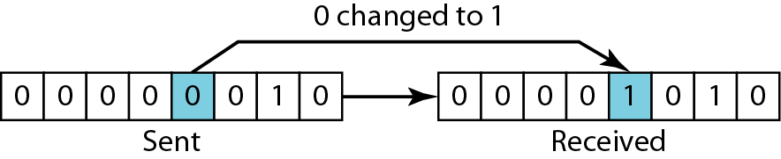
Single-bit error

Slide 10
Note
A burst error means that 2 or more bits in the data unit have changed.

Slide 11
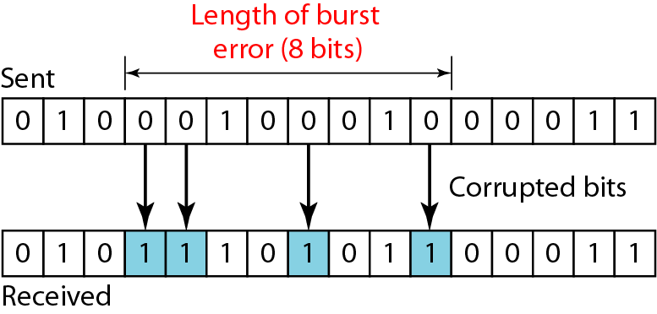
Burst error of length 8

Slide 12
Note
To detect or correct errors, we need to send extra (redundant) bits with data.

Slide 13
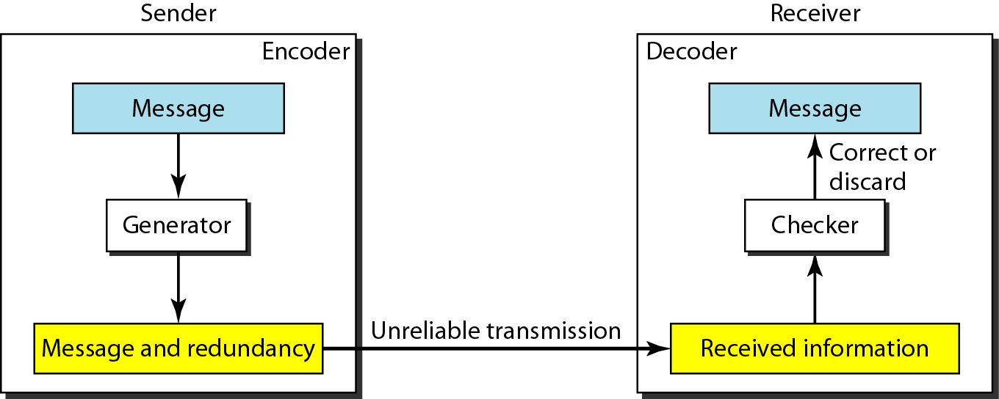
The structure of encoder and decoder

Slide 14
10-2 BLOCK CODING
In block coding, we divide our message into blocks, each of k bits, called datawords. We add r redundant bits to each block to make the length n = k + r. The resulting n-bit blocks are called codewords.
Topics discussed in this section:
Error Detection Error Correction Hamming Distance
Minimum Hamming Distance

Slide 15
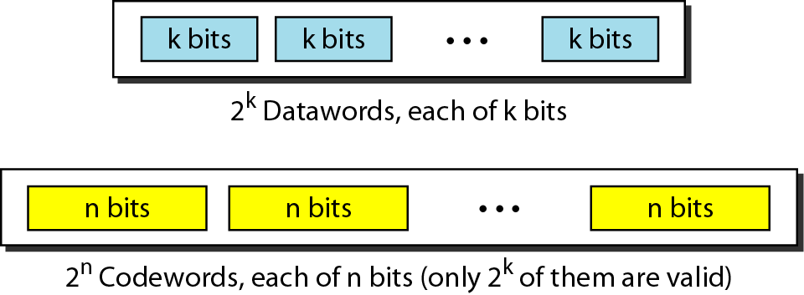
Datawords and codewords in block coding

Slide 16
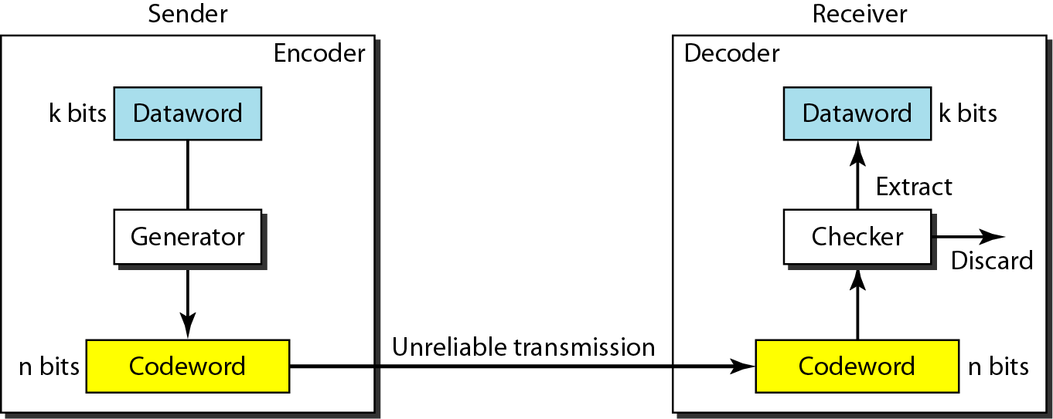
Process of error detection in block coding

Slide 17
Note
An error-detecting code can detect only the types of errors for which it is designed; other types of errors may remain undetected.

Slide 18
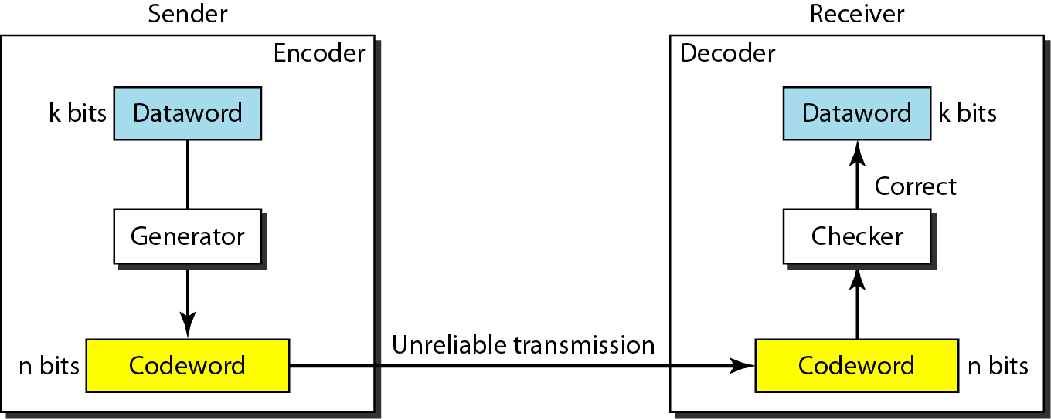
Structure of encoder and decoder in error correction

Slide 19
Note
The Hamming distance between two words is the number of differences between corresponding bits.

Slide 20
Note
The minimum Hamming distance is the smallest Hamming distance between all possible pairs in a set of words.

Slide 21
CHECKSUM
The last error detection method discussed here is called the checksum. The checksum is used in the Internet by several protocols although not at the data link layer.
Topics discussed in this section:
Idea One’s Complement Internet Checksum

Slide 22
Sender side checksum calculation:
The message is divided into 16-bit words.
The value of the checksum word is set to 0.
All words including the checksum are added using one’s complement addition.
The sum is complemented and becomes the checksum.
The checksum is sent with the data.

Slide 23
Receiver side checksum calculation:
The message (including checksum) is divided into 16-bit words.
All words are added using one’s complement addition.
The sum is complemented and becomes the new checksum.
If the value of checksum is 0, the message is accepted; otherwise, it is rejected.

Slide 24
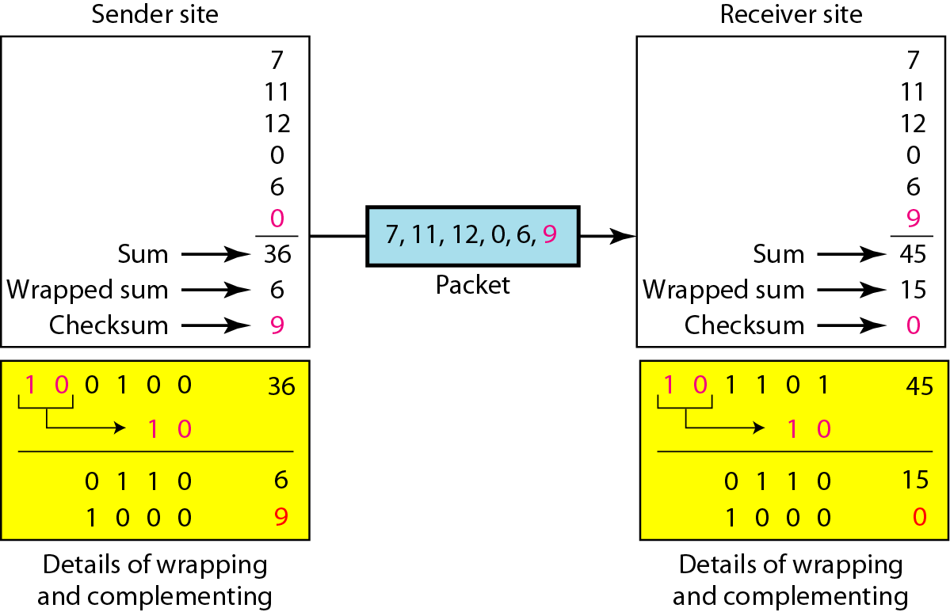
Calculation of Checksum in the sender side and receiver side

Slide 25
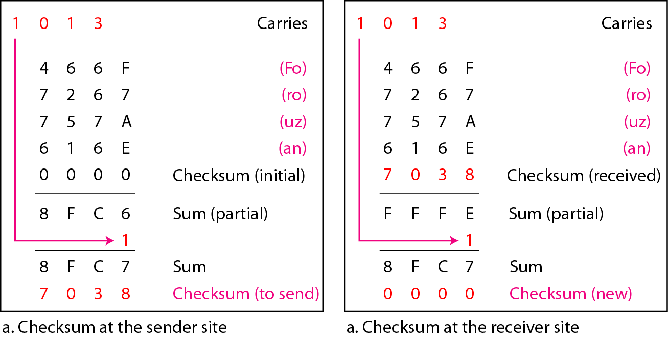
Example

Slide 26
What kind of error is undetectable by the checksum?
The traditional checksum uses a small number of bits (16) to detect errors in a message of any size (sometimes thousands of bits). However, it is not as strong as the CRC in error-checking capability. For example, if the value of one word is incremented and the value of another word is decremented by the same amount, the two errors cannot be detected because the sum and checksum remain the same. Also if the values of several words are incremented but the total change is a multiple of 65535, the sum and the checksum does not change, which means the errors are not detected.

Slide 27
Chapter 12
Multiple Access

Slide 28
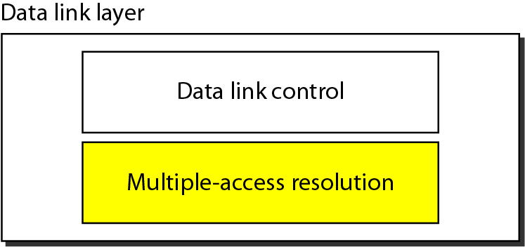
Data link layer divided into two functionality-oriented sublayers

Slide 29
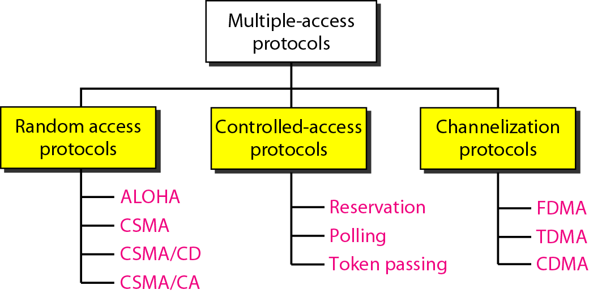
Summary of multiple-access protocols discussed in this chapter

Slide 30
*RANDOM ACCESS
In random access or contention methods, no station is superior to another station and none is assigned the control over another. No station permits, or does not permit, another station to send. At each instance, a station that has data to send uses a procedure defined by the protocol to make a decision on whether or not to send.
Topics discussed in this section:
ALOHA Carrier Sense Multiple Access
Carrier Sense Multiple Access with Collision Detection
Carrier Sense Multiple Access with Collision Avoidance

Slide 31
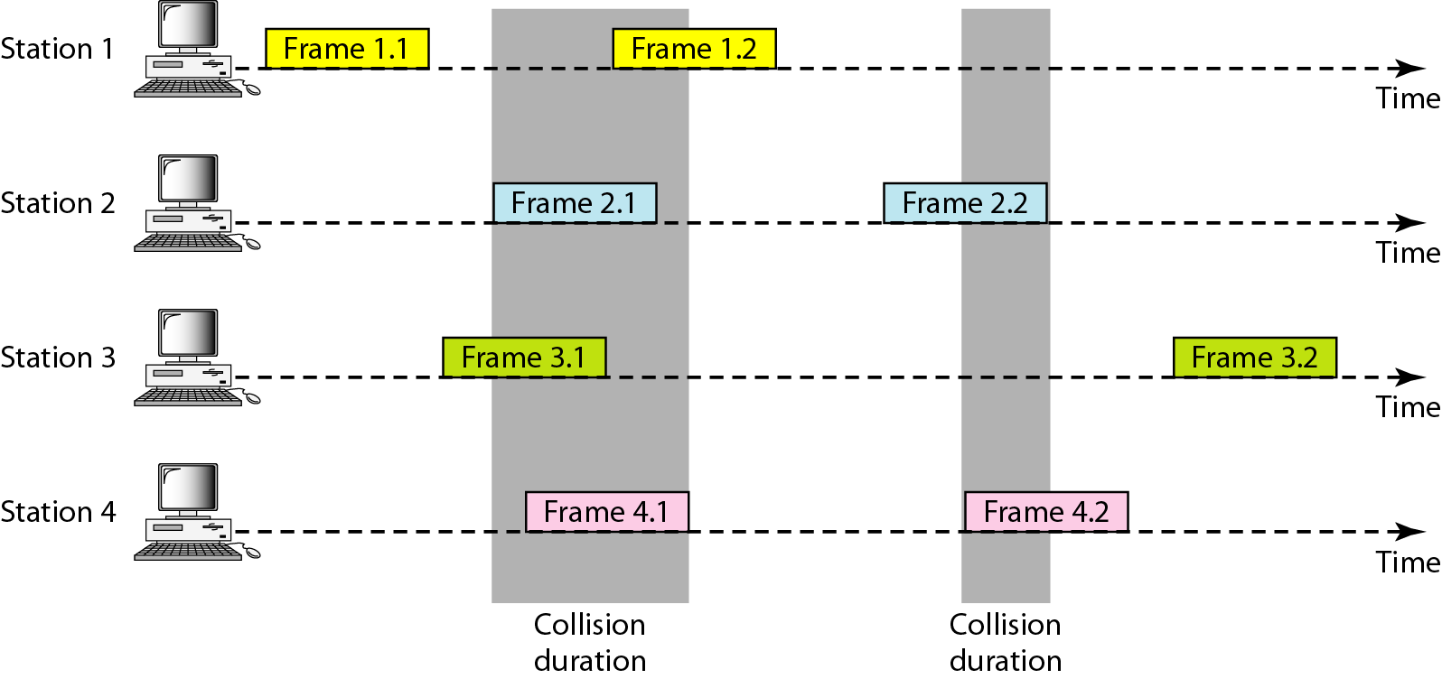
Frames in a pure ALOHA network

Slide 32
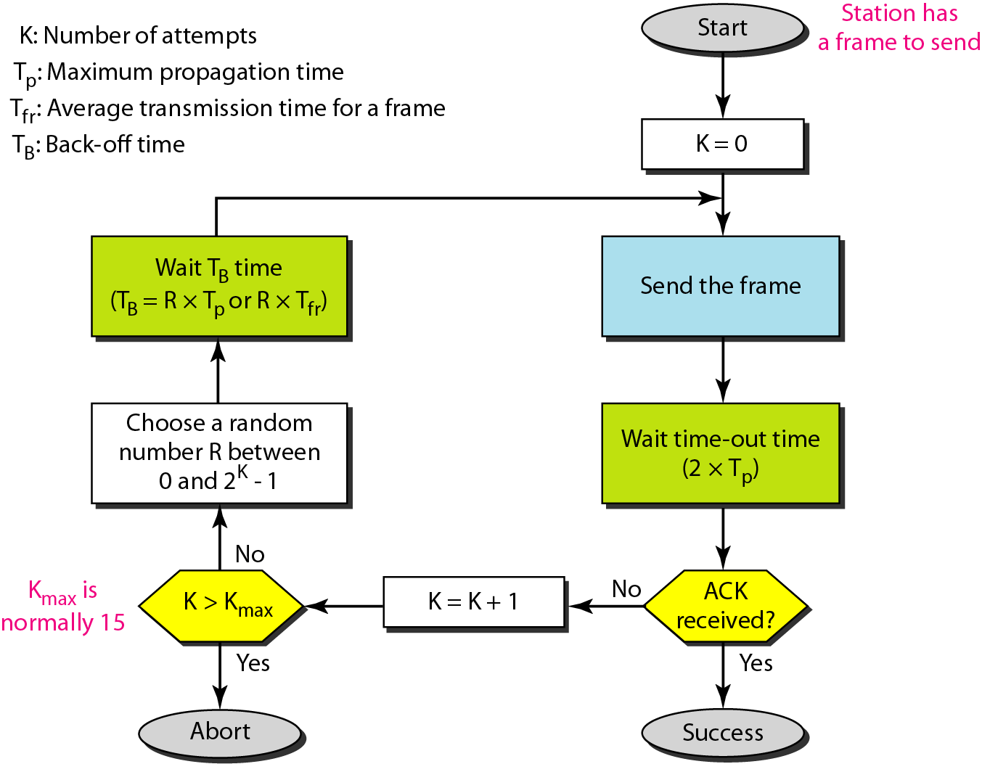
Procedure for pure ALOHA protocol

Slide 33
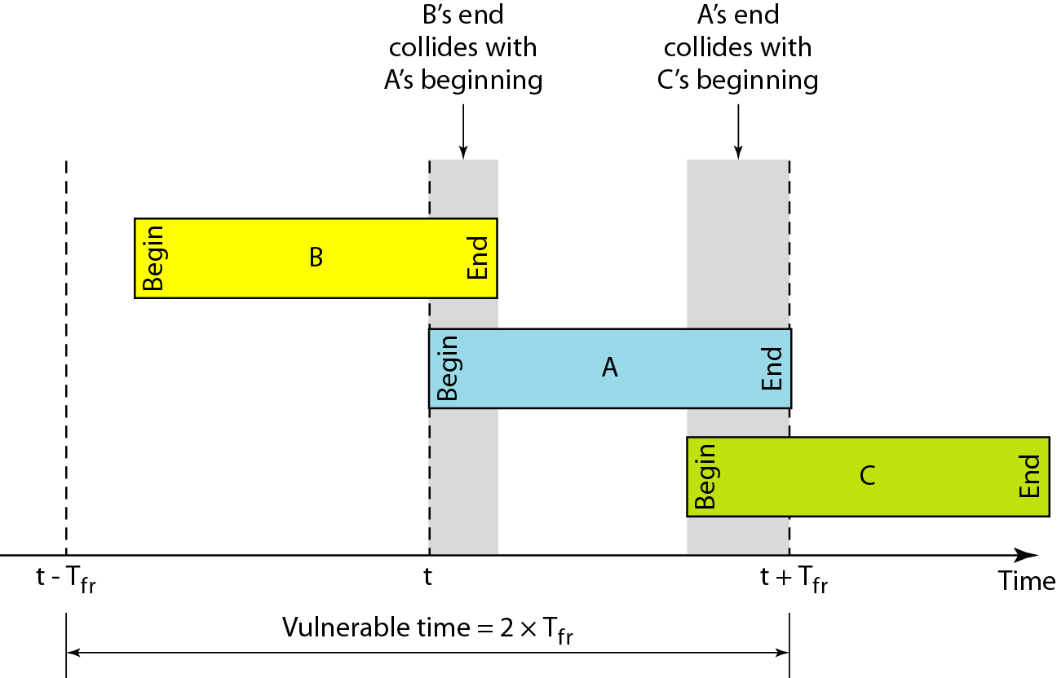
Vulnerable time for pure ALOHA protocol

Slide 34
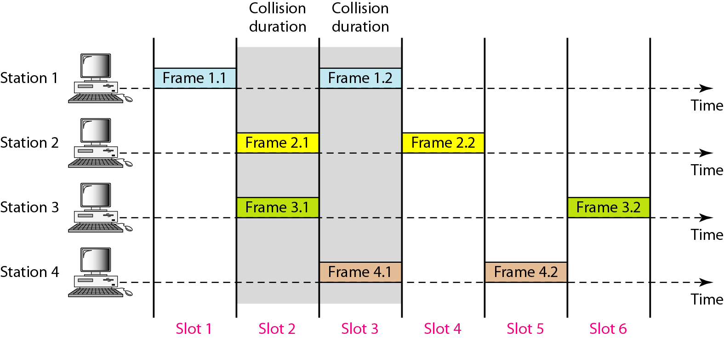
Frames in a slotted ALOHA network

Slide 35
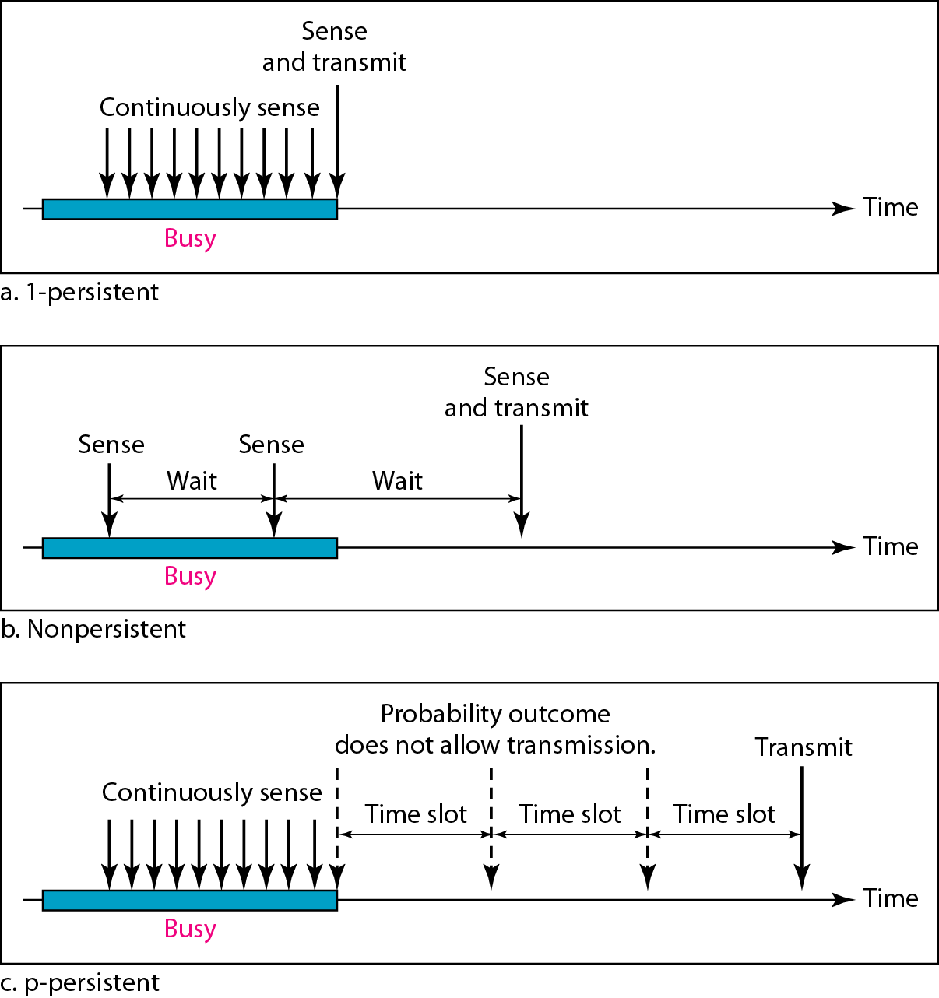
Behavior of three persistence methods

Slide 36
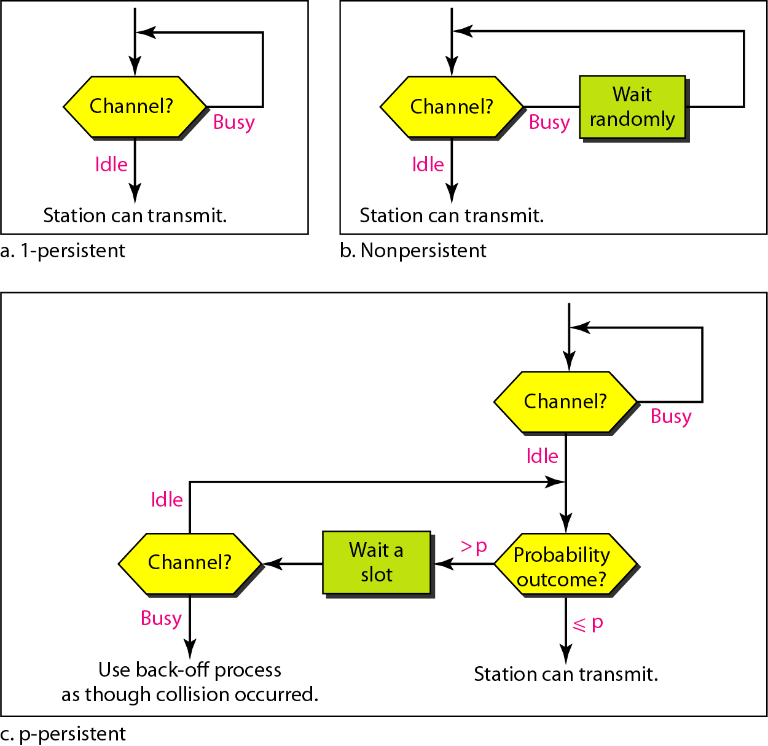
Flow diagram for three persistence methods

Slide 37
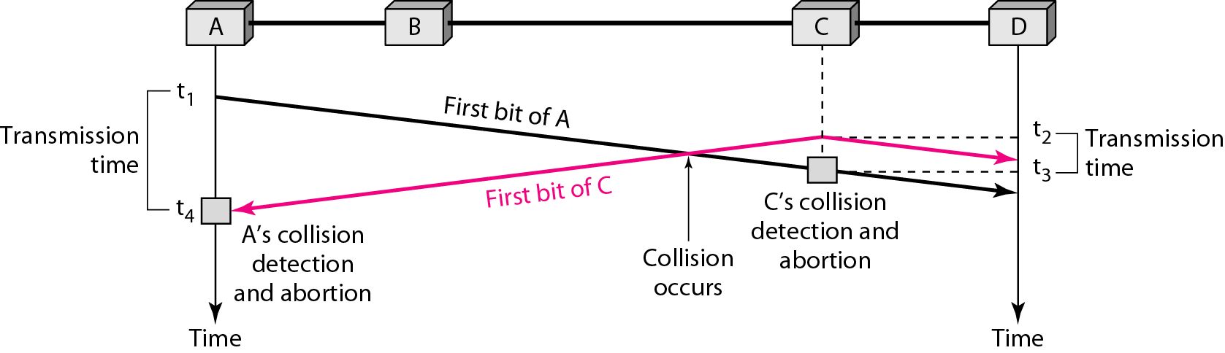
Collision of the first bit in CSMA/CD

Slide 38
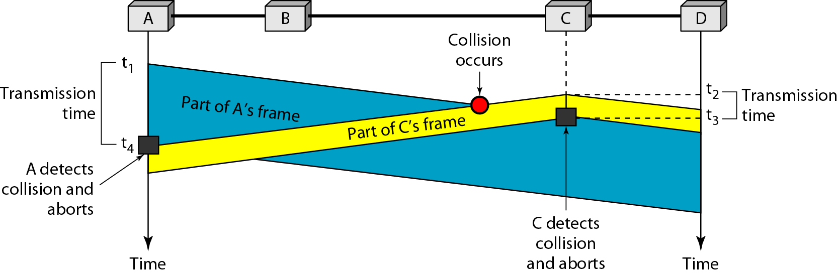
Collision and abortion in CSMA/CD

Slide 39
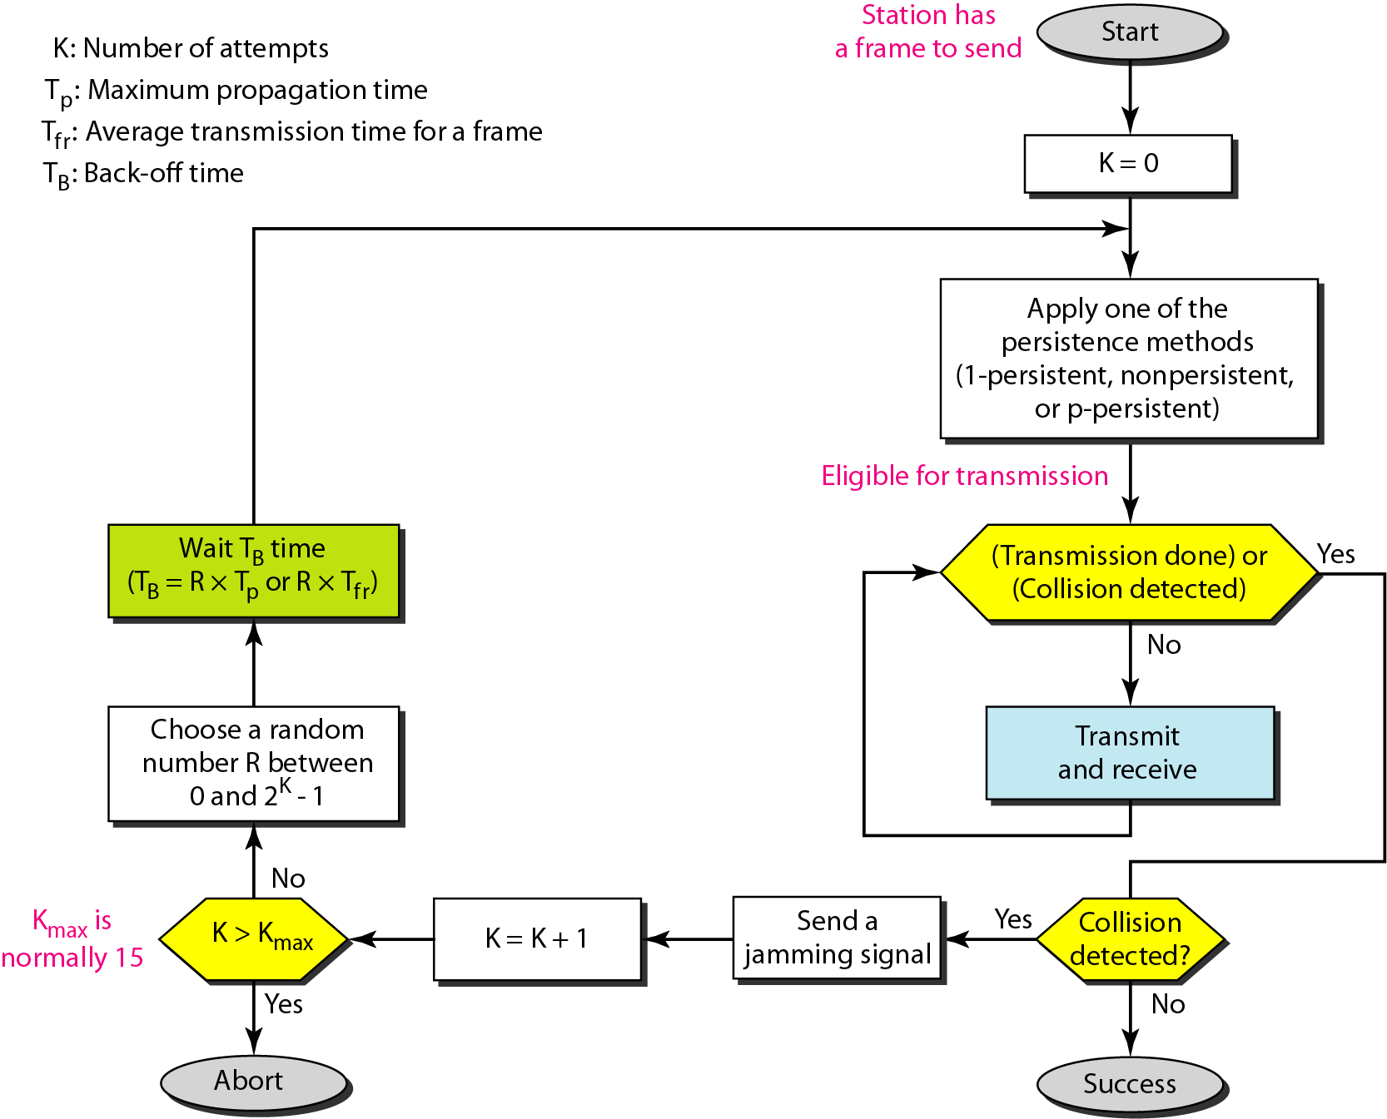
Flow diagram for the CSMA/CD

Slide 40
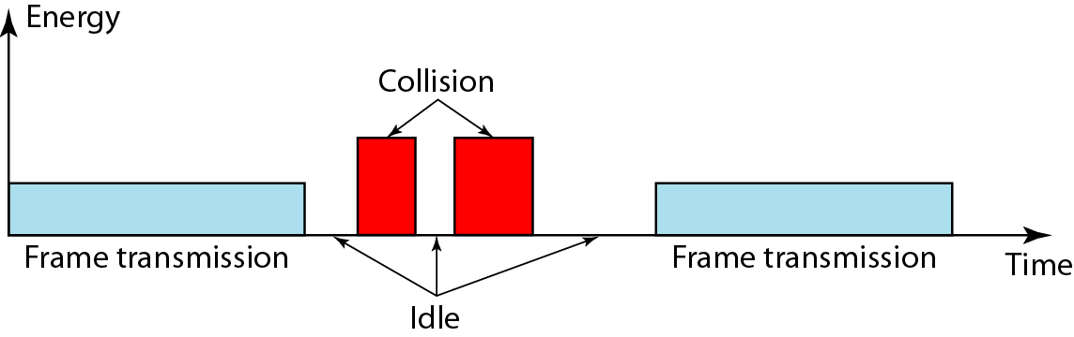
Energy level during transmission, idleness, or collision

Slide 41
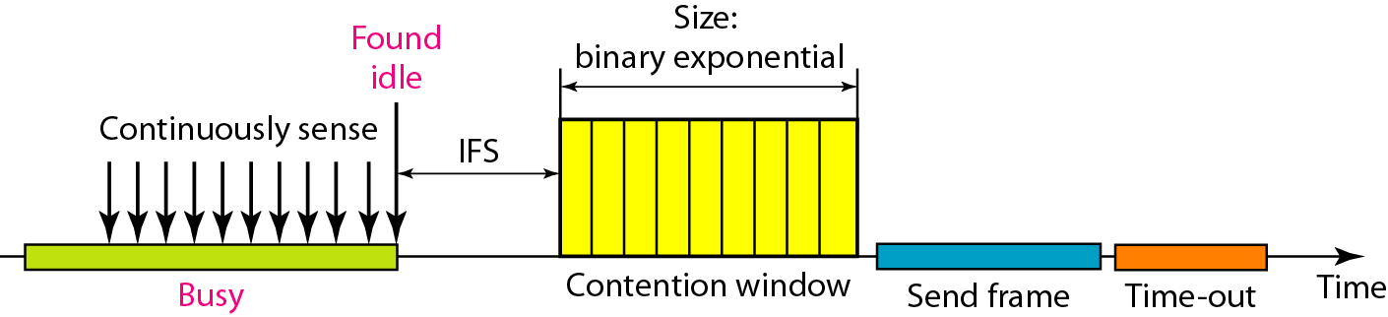
Timing in CSMA/CA

Slide 42
In CSMA/CA, the IFS can also be used to define the priority of a station or a frame.

Slide 43
In CSMA/CA, if the station finds the channel busy, it does not restart the timer of the contention window;
it stops the timer and restarts it when the channel becomes idle.

Slide 44
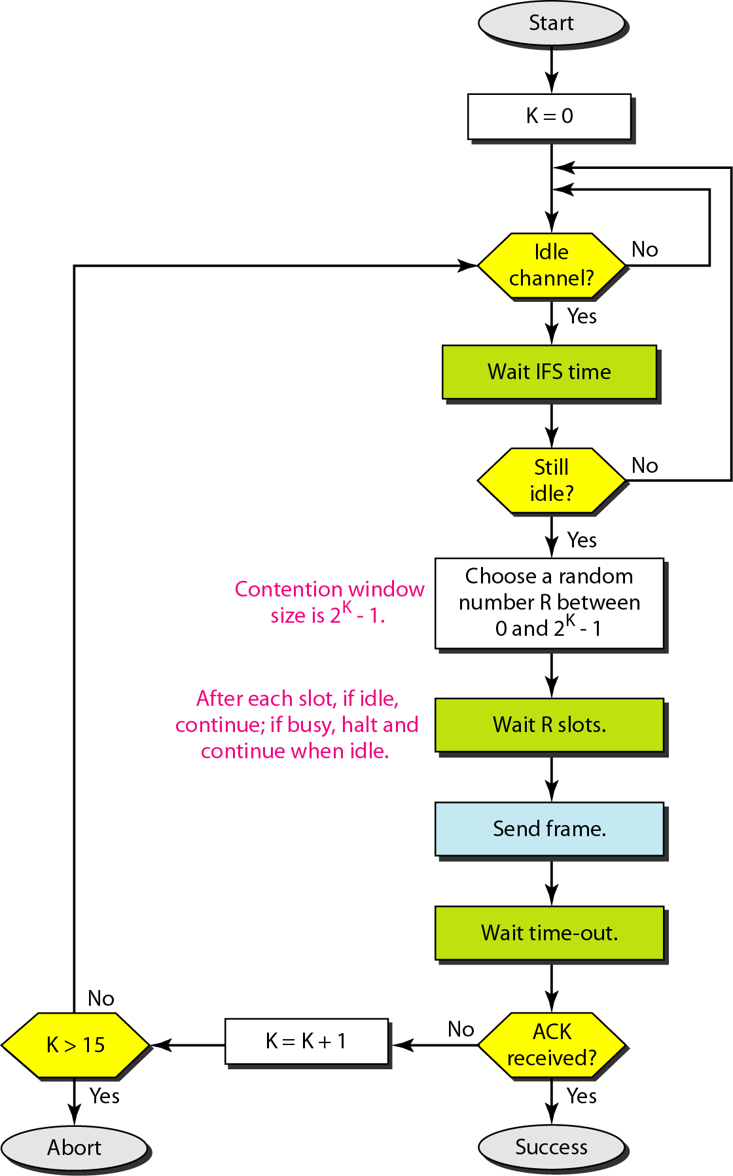
Flow diagram for CSMA/CA

Slide 45
*CONTROLLED ACCESS
In controlled access, the stations consult one another to find which station has the right to send. A station cannot send unless it has been authorized by other stations. We discuss three popular controlled-access methods.
Reservation Polling Token Passing

Slide 46
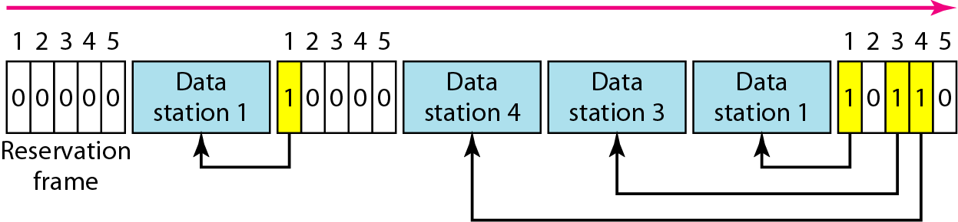
Reservation access method

Slide 47
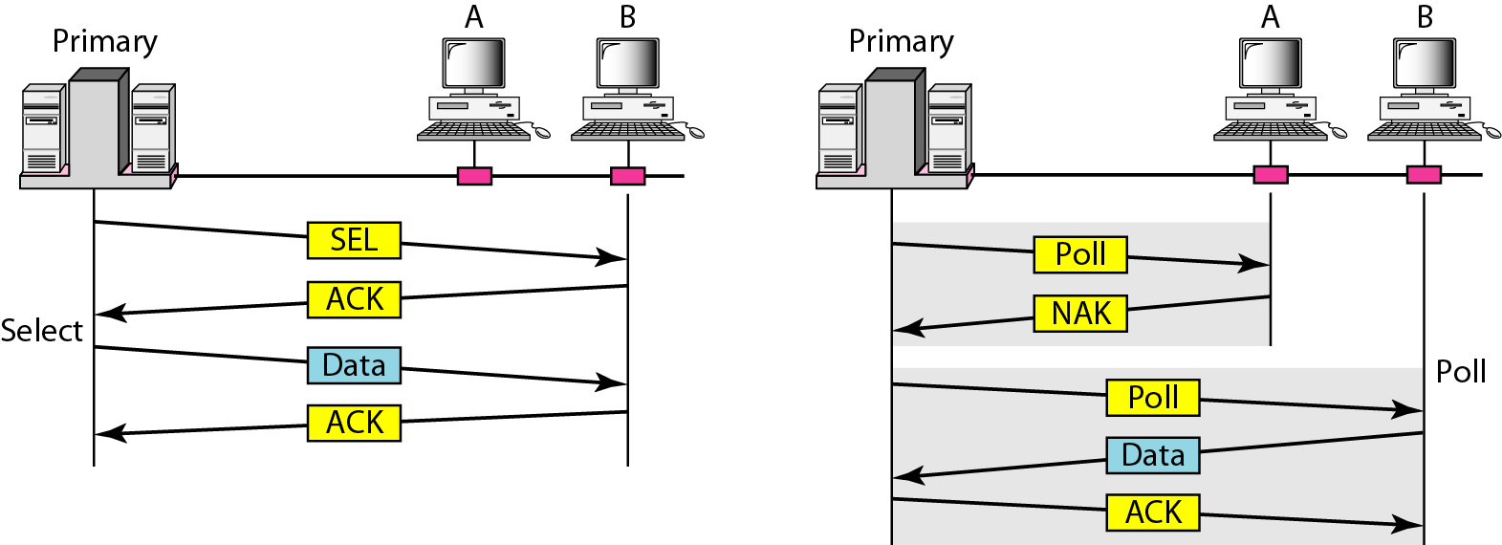
Select and poll functions in polling access method

Slide 48
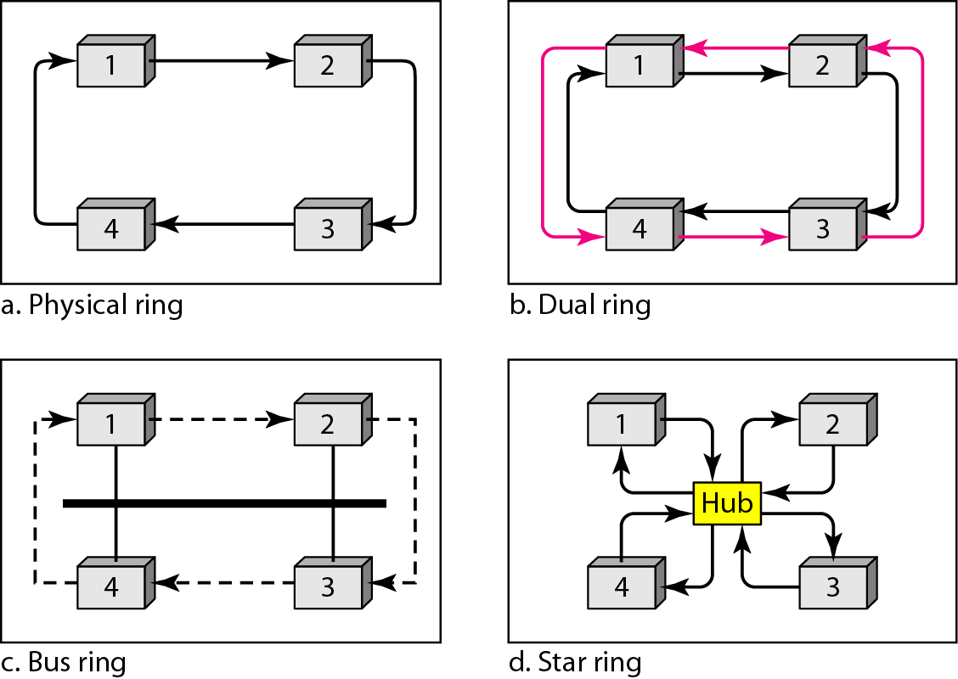
Logical ring and physical topology in token-passing access method

Slide 49
*CHANNELIZATION
Channelization is a multiple-access method in which the available bandwidth of a link is shared in time, frequency, or through code, between different stations. In this section, we discuss three channelization protocols.
Frequency-Division Multiple Access (FDMA) Time-Division Multiple Access (TDMA)
Code-Division Multiple Access (CDMA)

Slide 50
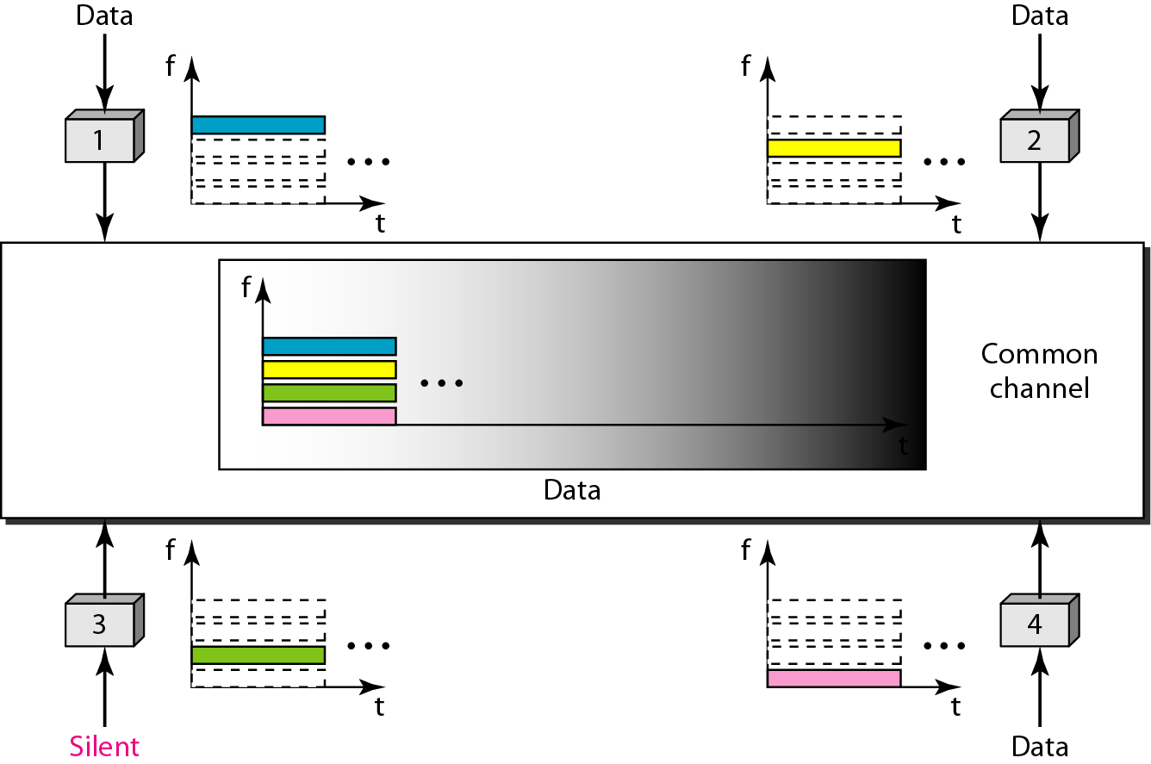
Frequency-division multiple access (FDMA)

Slide 51
In FDMA, the available bandwidth of the common channel is divided into bands that are separated by guard bands.

Slide 52
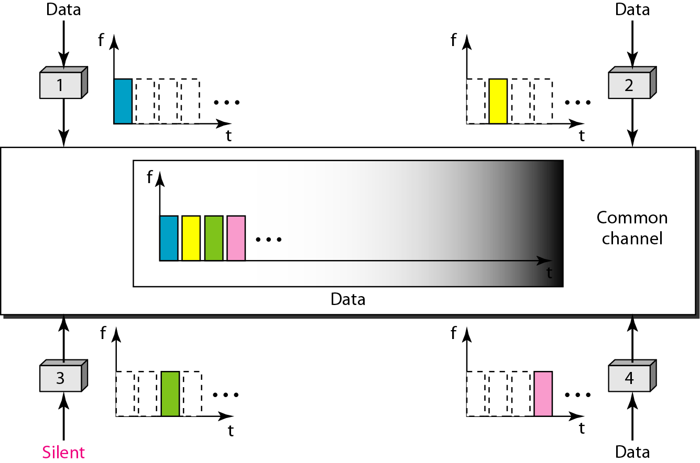
Time-division multiple access (TDMA)

Slide 53
In TDMA, the bandwidth is just one channel that is time shared between different stations.

Slide 54
In CDMA, one channel carries all transmissions simultaneously.

Slide 55
Chapter 14
Wireless LANs

Slide 56
IEEE 802.11
IEEE has defined the specifications for a wireless LAN, called IEEE 802.11, which covers the physical and data link layers.
Topics discussed in this section:
Architecture MAC Sublayer
Physical Layer

Slide 57
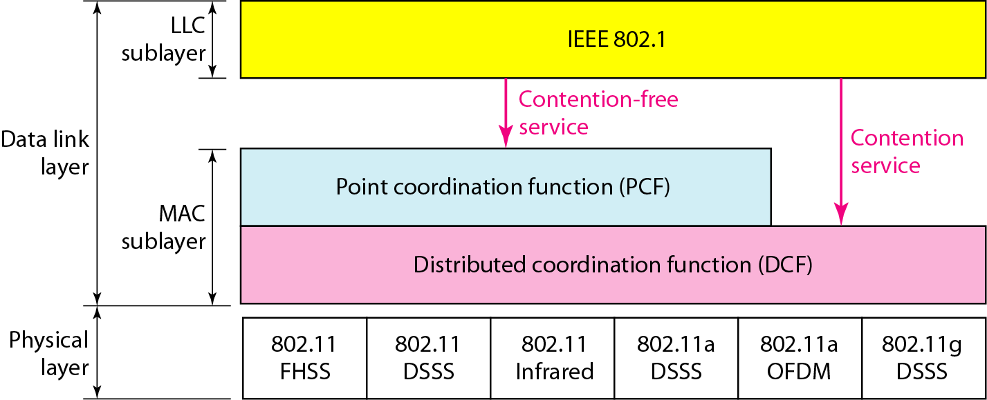
Figure 14.3 MAC layers in IEEE 802.11 standard

Slide 58
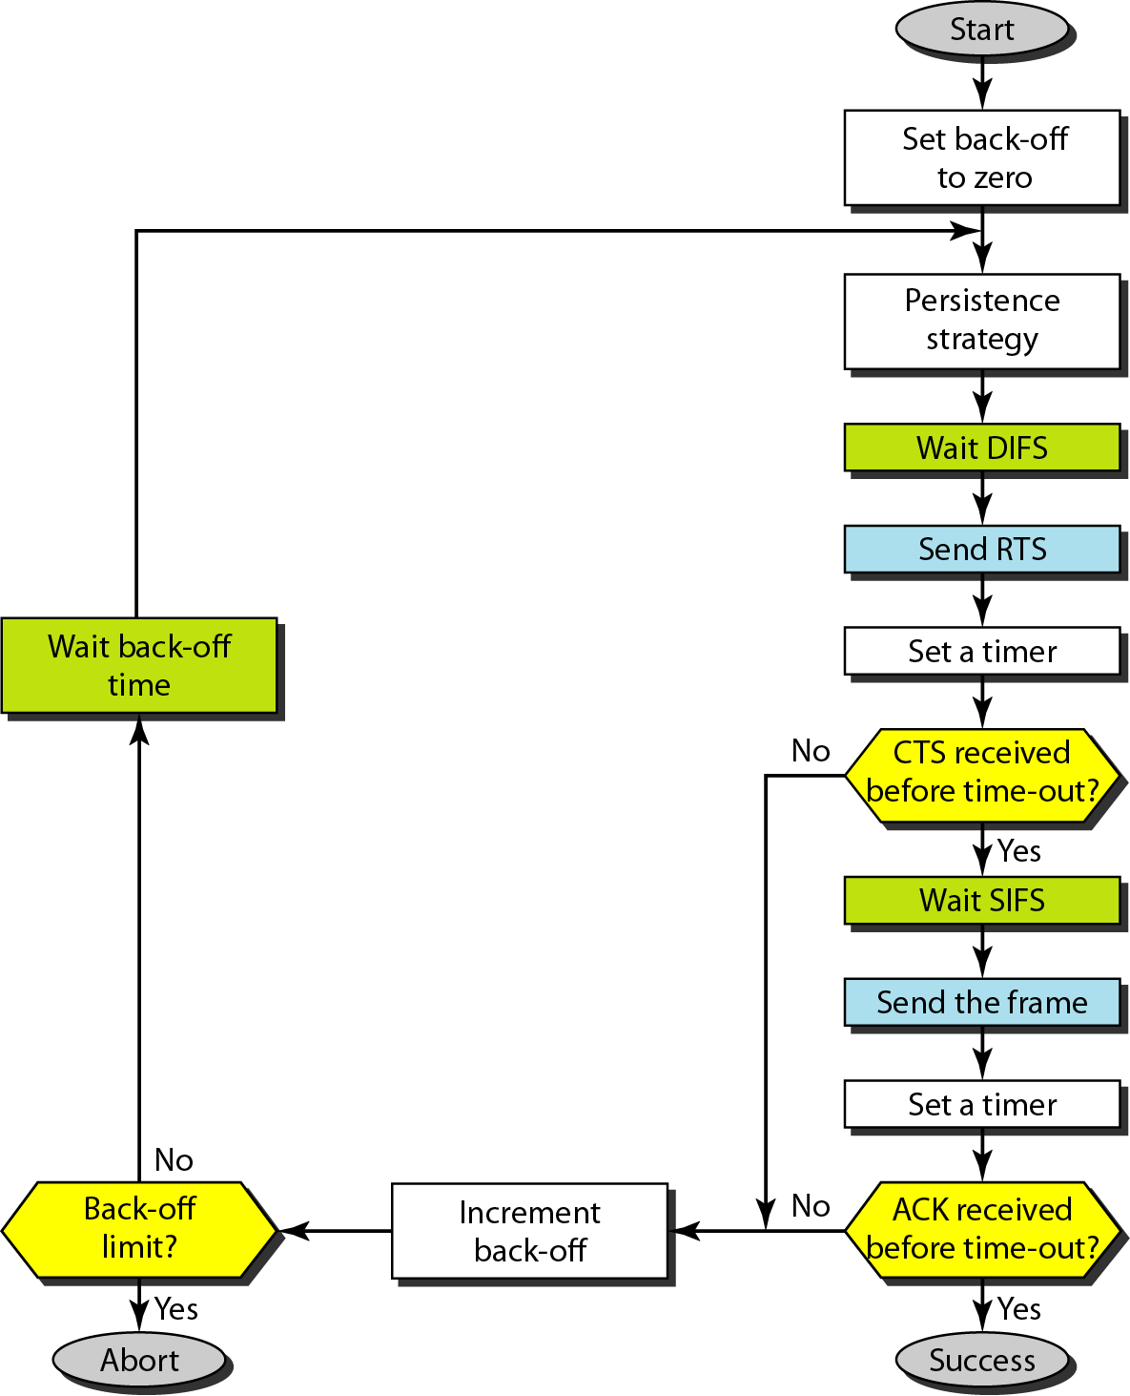
Figure 14.4 CSMA/CA flowchart

Slide 59
BLUETOOTH
Bluetooth is a wireless LAN technology designed to connect devices of different functions such as telephones, notebooks, computers, cameras, printers, coffee makers, and so on. A Bluetooth LAN is an ad hoc network, which means that the network is formed spontaneously.
Architecture Bluetooth Layers Baseband Layer
L2CAP

Slide 60
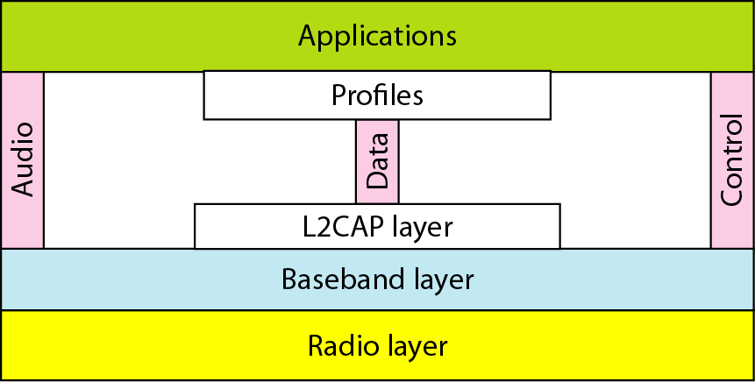
Bluetooth layers

Slide 61
Chapter 15
Connecting Devices
Hubs
Repeaters
Bridges
Switches
Routers
Gateway

Slide 62
CONNECTING DEVICES
In this section, we divide connecting devices into five different categories based on the layer in which they operate in a network.
Passive Hubs
Active Hubs
Bridges
Two-Layer Switches
Routers
Three-Layer Switches
Gateways

Slide 63
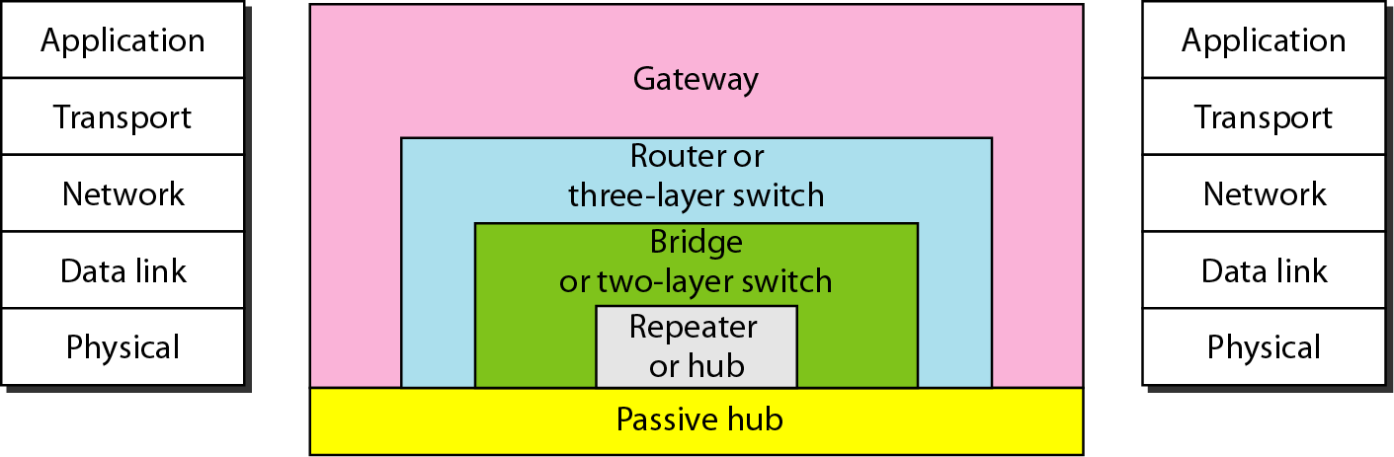
Five categories of connecting devices

Slide 64
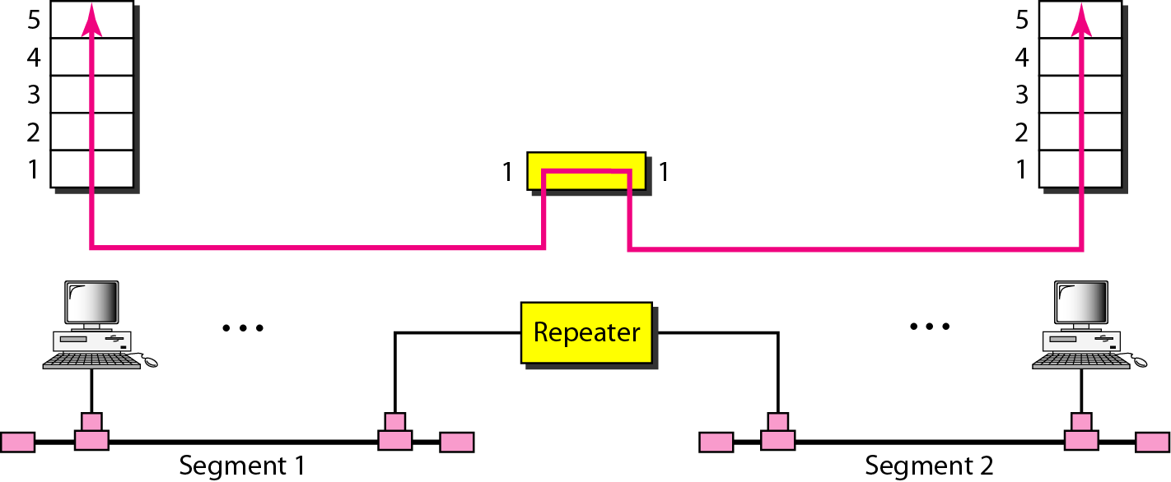
A repeater connecting two segments of a LAN
A repeater is a connecting device that operates in the physical layer of the Internet model. A repeater generates a signal, connects segments of a LAN, and has no filtering capability.

Slide 65
Note
A repeater connects segments of a LAN.

Slide 66
Note
A repeater forwards every frame; it has no filtering capability.

Slide 67
Note
A repeater is a regenerator, not an amplifier.

Slide 68
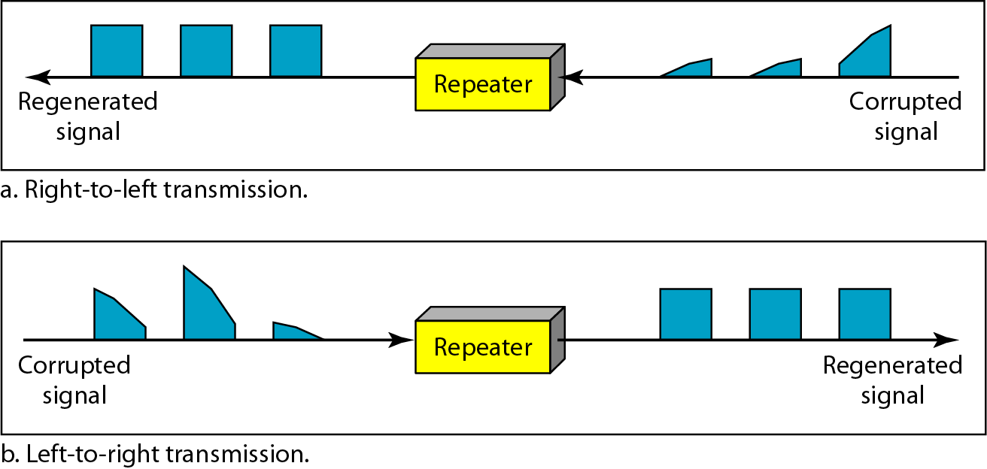
Function of a repeater

Slide 69
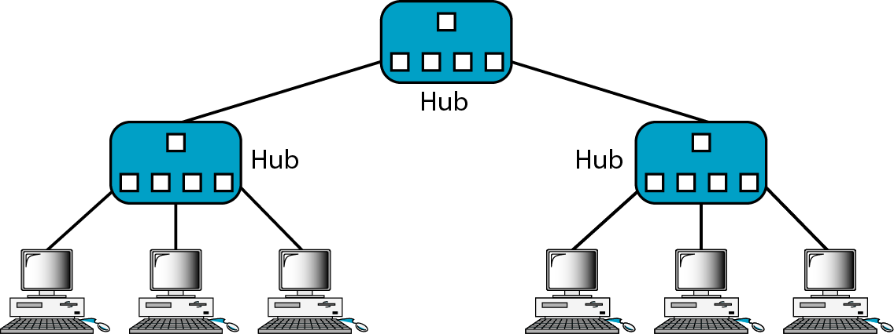
A hierarchy of hubs

Slide 70
Note
A bridge has a table used in filtering decisions.

Slide 71
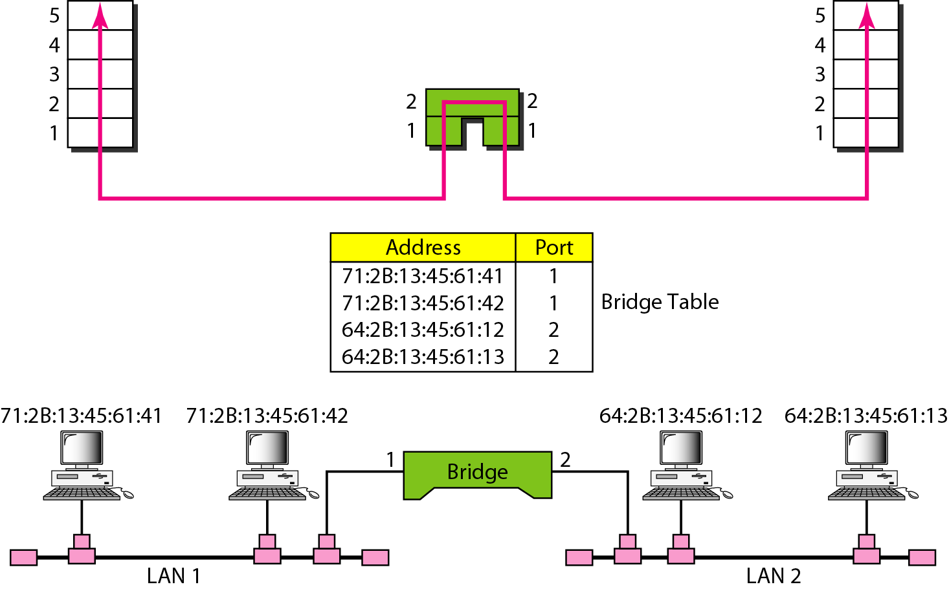
A bridge connecting two LANs

Slide 72
Note
A bridge does not change the physical (MAC) addresses in a frame.

Slide 73
UNIT 4

Slide 74
Unit-4
Network Layer: & Transport Layer
Network Layer: Addressing IPV4 addresses - IPV6 Addresses Internet Protocol:IPv4 – IPv6Address mapping protocols: ARP – RARP Routing protocols: Unicast routing protocols: distance vector routing, Link State routing Multicast Routing protocols (Any two) Transport Layer: Process to process delivery – UDP – TCP Congestion control and QOS: Data traffic – congestion – congestion control – quality of service – techniques to improve quality of service.

Slide 75
Unit-4 Teaching Hours: 10
Network Layer: & Transport Layer
Chapter 19 Network Layer Logical Addressing: IPv4 Addresses - IPV6 Addresses.
Chapter 20 Network Layer Internet Protocol: IPv4 – IPv6.
Chapter 21 Address Mapping Protocols: ARP – RARP.
Chapter 22 Routing protocols: UNICAST ROUTING PROTOCOLS: Distance vector routing, Link State routing. MULTICAST ROUTING PROTOCOLS (Any two).
Chapter 23 Transport Layer: Process to process delivery: UDP – TCP.
Chapter 24 Congestion control and Quality of Service (QoS): Data traffic – Congestion – Congestion control – Quality of service – Techniques to improve quality of service.

Slide 76
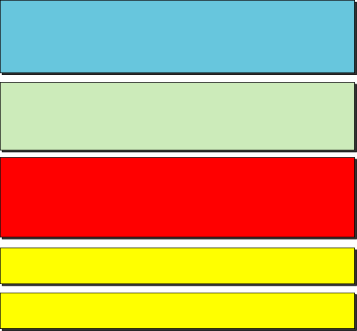
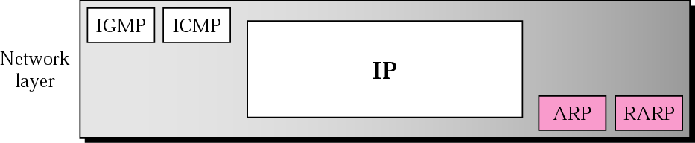
ARP and RARP
Address Resolution Protocol and Reverse Address Resolution Protocol
Position of ARP and RARP in TCP/IP protocol suite
76
Notes:
76
76

Slide 77
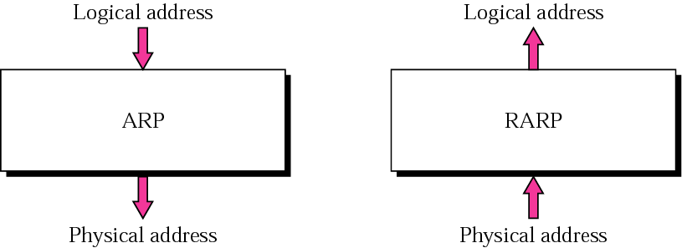
ARP and RARP
In dynamic mapping each time a machine knows one of the two addresses, it can use a protocol to find the other one.
Two protocols have been designed to perform dynamic mapping: Address resolution protocol(ARP) and Reverse address resolution protocol(RARP).
ARP maps a logical address to a physical address.
RARP maps a physical address to a logical address.
Notes:
77
77

Slide 78
ARP
ARP associates an IP address with its physical address. On a typical physical network, such as a LAN, each device on a link is identified by a physical or station address that is usually imprinted on the NIC.
The topics discussed in this section include:
Packet Format
Encapsulation
Operation
ARP over ATM
Proxy ARP
78
Notes:
78
78

Slide 79
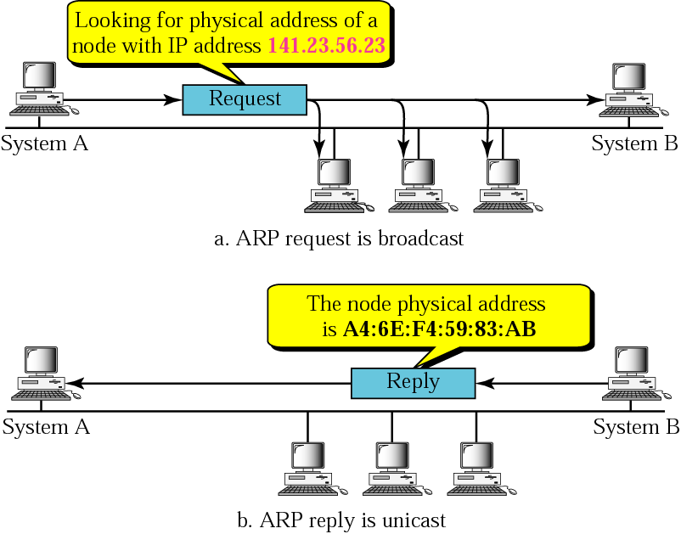
ARP operation
79
Notes:
79
79

Slide 80
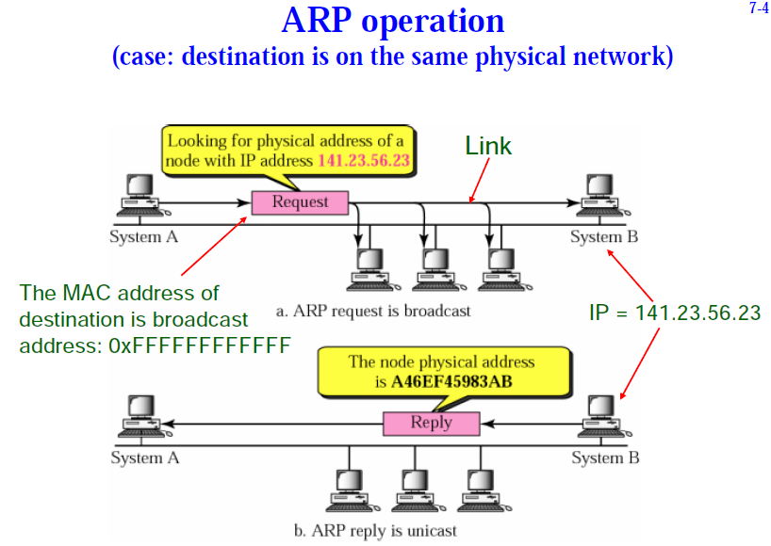
Notes:
80
80

Slide 81
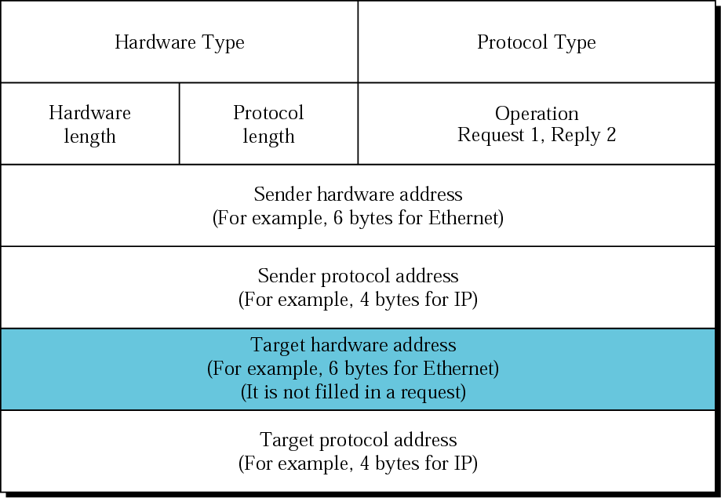
*ARP packet
Notes:
81
81

Slide 82
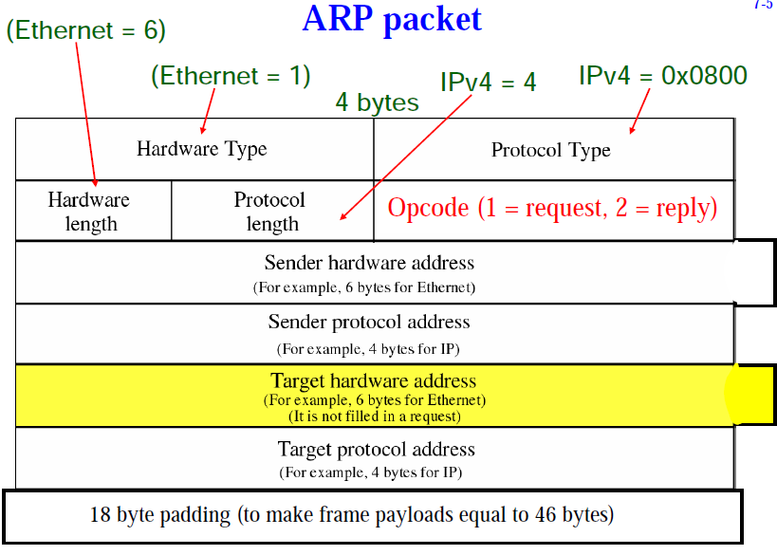
TCP/IP Protocol Suite
82
Notes:
82
82

Slide 83
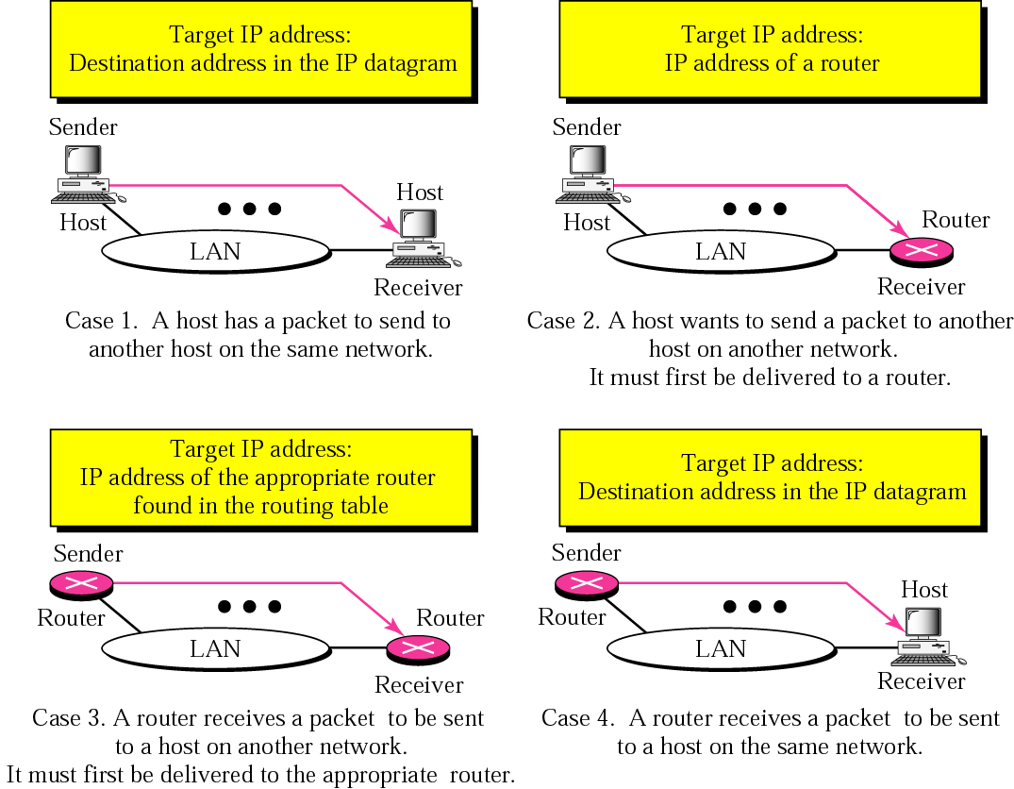
Four cases using ARP
Notes:
83
83

Slide 84

Note
An ARP request is broadcast; an ARP reply is unicast.
84
Notes:
84
84

Slide 85
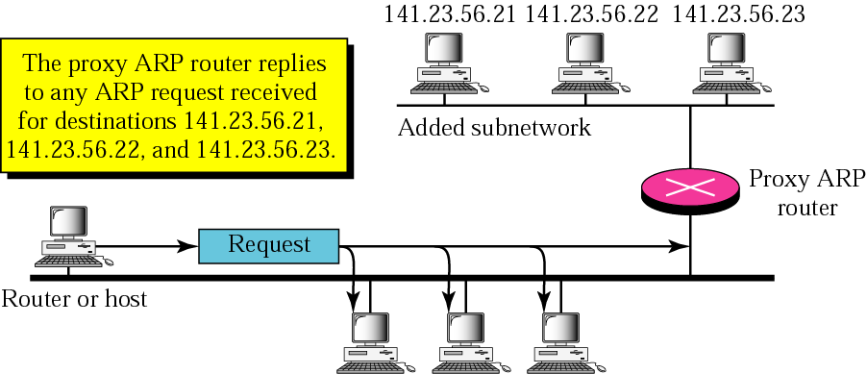
Proxy ARP
A proxy ARP is an ARP that acts on behalf of a set of hosts.
85
Notes:
85
85

Slide 86
RARP
RARP finds the logical address for a machine that only knows its physical address.
The topics discussed in this section include:
Packet Format
Encapsulation
RARP Server
Alternative Solutions to RARP
TCP/IP Protocol Suite
86
Notes:
86
86

Slide 87
Note:
The RARP request packets are broadcast;
the RARP reply packets are unicast.
87

Slide 88
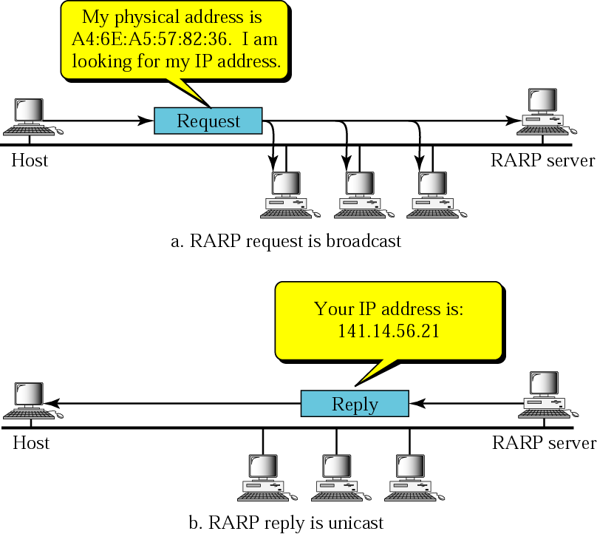
RARP operation
TCP/IP Protocol Suite
88

Slide 89
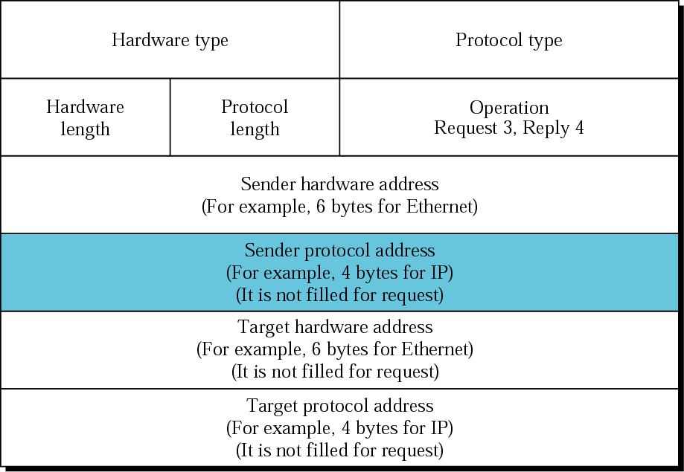
RARP packet

Slide 90

Chapter 22
Network Layer: Delivery, Forwarding, and Routing
Syllabus
UNICAST ROUTING PROTOCOLS:
Distance vector routing
Link State routing
MULTICAST ROUTING PROTOCOLS
Source-Based Tree Approach
Group-Shared Tree Approach

Slide 91
* UNICAST ROUTING PROTOCOLS
A routing table can be either static or dynamic. A static table is one with manual entries. A dynamic table is one that is updated automatically when there is a change somewhere in the Internet. A routing protocol is a combination of rules and procedures that lets routers in the Internet inform each other of changes.
* Intra- and Interdomain Routing
* Distance Vector Routing and RIP
* Link State Routing and OSPF
Path Vector Routing and BGP

Slide 92
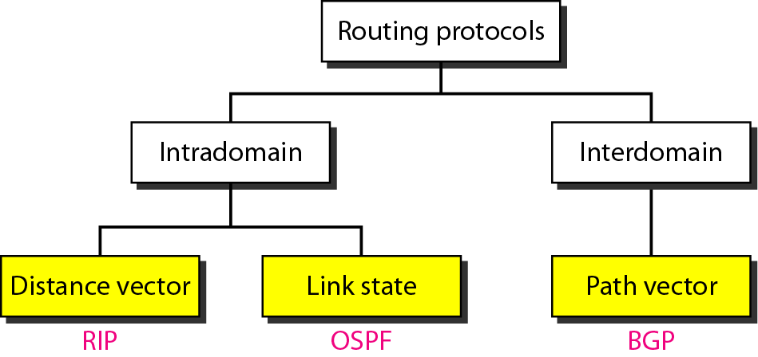
Popular routing protocols

Slide 93
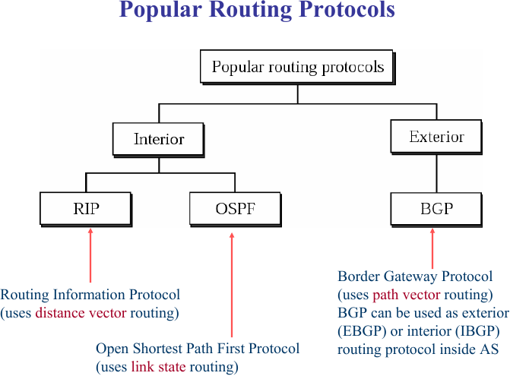

Slide 94
* Distance vector routing
Several routing algorithms, and the corresponding protocols, have been devised to find the best route among them; three have survived. In distance-vector routing, the first thing each node creates is its own least-cost tree with the rudimentary information it has about its immediate neighbours. The incomplete trees are exchanged between immediate neighbours to make the trees more and more complete and to represent the whole internet. In other words, in distance-vector routing, a router continuously tells all of its neighbours what it knows about the whole internet. The protocol that implements distance-vector routing is called Routing Information Protocol (RIP).

Slide 95
* Link state routing
Another routing algorithm that has been used in the Internet is link-state routing. This method uses the term link-state to define the characteristic of a link (an edge) that represents a network in the internet. In this algorithm the cost associated with an edge defines the state of the link. In this algorithm, all routers flood the internet, with information related to their link states. When every router has the complete picture of the states, a link-state database can be created. The least-cost tree for each router and the corresponding forwarding table can be made from the link-state database. A protocol that implements link-state routing is called Open Shortest Path First (OSPF).

Slide 96
Path-vector routing
Both link-state and distance-vector routing are based on the least-cost goal. However, there are instances where this goal is not the priority. Path-vector routing algorithms have been designed for this purpose. We can always insert policies in the forwarding table by preventing a packet from visiting a specific router. In path-vector routing, the best route from the source is the best path, the one that complies with the policy imposed. The protocol that implements path-vector routing is the Border Gateway Protocol (BGP).

Slide 97
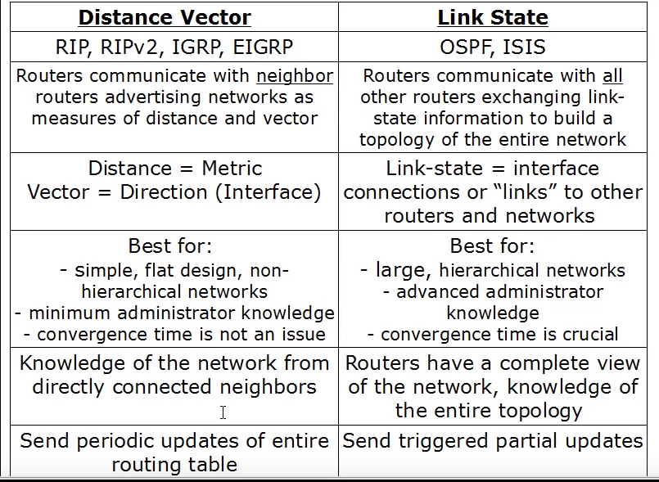

Slide 98
MULTICAST ROUTING PROTOCOLS
Multicasting
Multicast routing protocols.
Topics discussed in this section:
Unicast, Multicast, and Broadcast Applications
Multicast Routing
Routing Protocols

Slide 99
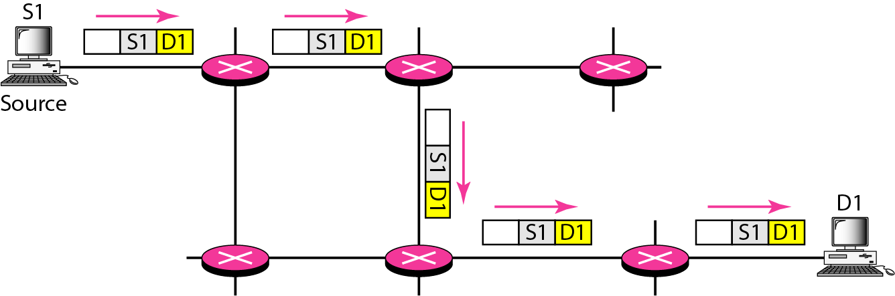
Unicasting
In unicasting, the router forwards the received packet through only one of its interfaces.

Slide 100

Multicasting
In multicasting, the router may forward the received packet through several of its interfaces.

Slide 101

Multicasting versus multiple unicasting

Slide 102

Taxonomy of common multicast protocols

Slide 103
* Source-Based Tree Approach
In the source-based tree approach to multicasting, each router needs to create a separate tree for each source-group combination. In other words, if there are m groups and n sources in the internet, a router needs to create (m × n) routing trees. In each tree, the corresponding source is the root, the members of the group are the leaves, and the router itself is somewhere on the tree. We can compare the situation with unicast routing in which a router needs only one tree with itself as the root and all networks in the internet as the leaves. Although it may appear that each router needs to create and store a huge amount of information about all of these trees, there are two protocols that use this approach in the Internet today. These protocols use some strategies that alleviate the situation.

Slide 104
* Group-Shared Tree Approach
In the group-shared tree approach, we designate a router to act as the core source for each group. The designated router, which is called the core router, acts as the representative for the group. Any source that has a packet to send to a member of that group sends it to the core center (unicast communication) and the core center is responsible for multicasting. The core center creates one single routing tree with itself as the root and any routers with active members in the group as the leaves. In this approach, there are m core routers (one for each group) and each core router has a routing tree, for the total of m trees. This means that the number of routing trees is reduced from (m × n) in the source-based tree approach to m in this approach. The reader may have noticed that we have divided a multicast delivery from the source to all group members into two deliveries. The first is a unicast delivery from the source to the core router; the second is the delivery from the core router to all group members. Note that the first part of the delivery needs to be done using tunneling. The multicast packet created by the source needs to be encapsulated in a unicast packet and sent to the core router. The core router decapsulates the unicast packet, extracts the multicast packet, and sends it to the group members. Although the reduction in number of trees in this approach looks very attractive, this approach has its own overhead: using an algorithm to select a router among all routers as the core router for a group.

Slide 105
Chapter 23
Process-to-Process Delivery:
UDP and TCP

Slide 106
PROCESS-TO-PROCESS DELIVERY
The transport layer is responsible for process-to-process delivery. The delivery of a packet, part of a message from one process to another. Two processes communicate in a client/server relationship.
Client/Server Paradigm Multiplexing and Demultiplexing
Connectionless Versus Connection-Oriented Service
Reliable Versus Unreliable
Three Protocols

Slide 107
Note
The transport layer is responsible for process-to-process delivery.

Slide 108

Types of data deliveries

Slide 109

Port numbers

Slide 110

IP addresses versus port numbers

Slide 111

IANA ranges

Slide 112

Socket address

Slide 113

Multiplexing and demultiplexing

Slide 114

Error control

Slide 115

Position of UDP, TCP, and SCTP in TCP/IP suite

Slide 116
USER DATAGRAM PROTOCOL (UDP)
The User Datagram Protocol (UDP) is called a connectionless, unreliable transport protocol. It does not add anything to the services of IP except to provide process-to-process communication instead of host-to-host communication.
Well-Known Ports for UDP User Datagram
Checksum
UDP Operation
Use of UDP

Slide 117

*User datagram format

Slide 118
Note
UDP length = IP length – IP header’s length

Slide 119

Queues in UDP

Slide 120
TCP
TCP is a connection-oriented protocol; it creates a virtual connection between two TCPs to send data. In addition, TCP uses flow and error control mechanisms at the transport level.
TCP Services TCP Features
Segment
A TCP Connection
Flow Control
Error Control

Slide 121

Stream delivery

Slide 122

Sending and receiving buffers

Slide 123

TCP segments

Slide 124
The bytes of data being transferred in each connection are numbered by TCP.
The numbering starts with a randomly generated number.

Slide 125
The value in the sequence number field of a segment defines the
number of the first data byte contained in that segment.

Slide 126
The value of the acknowledgment field in a segment defines the number of the next byte a party expects to receive.
The acknowledgment number is cumulative.

Slide 127

*TCP segment format

Slide 128

Control field

Slide 129

Description of flags in the control field

Slide 130

Connection establishment using three-way handshaking

Slide 131
A SYN segment cannot carry data, but it consumes one sequence number.

Slide 132
A SYN + ACK segment cannot carry data, but does consume one sequence number.

Slide 133
An ACK segment, if carrying no data, consumes no sequence number.

Slide 134

Data transfer

Slide 135

Connection termination using three-way handshaking

Slide 136
The FIN segment consumes one sequence number if it does not carry data.

Slide 137
The FIN + ACK segment consumes one sequence number if it does not carry data.

Slide 138

Sliding window

Slide 139
A sliding window is used to make transmission more efficient as well as
to control the flow of data so that the destination does not become
overwhelmed with data. TCP sliding windows are byte-oriented.

Slide 140
The receiver TCP delivers only ordered data to the process.

Slide 141
UNIT 5 Syllabus
Chap 25 DNS: Name space, domain name space, distribution of name space.
Chap 26 Electronic-mail, Architecture, FILE transfer: FTP.
Chap 27 WWW and HTTP: Architecture web documents, HTTP.
Chap 30 Network Security: Introduction, definitions, two categories, symmetric key cryptography, traditional ciphers, asymmetric key cryptography.

Slide 142
Chapter 25
Domain Name System
Topics discussed in this section:
Domain
Domain Name
Name-Address Resolution.
Root server.
Hierarchical name space.
Distribution of name space.
DNS in the Internet.
Flat name space.
25.142

Slide 143
Domain Name System
The Domain Name System is client-server application that identifies each host on the Internet with a unique user-friendly name.
DNS organizes the name space in a hierarchical structure to decentralize the responsibilities involved in naming.
25.143

Slide 144

Example of using the DNS service
25.144

Slide 145
NAME SPACE
To be unambiguous, the names assigned to machines must be carefully selected from a namespace with complete control over the binding between the names and IP addresses.
Topics discussed in this section:
Flat Name Space Hierarchical Name Space
25.145

Slide 146
DOMAIN NAME SPACE
To have a hierarchical name space, a domain name space was designed. In this design the names are defined in an inverted-tree structure with the root at the top. The tree can have only 128 levels: level 0 (root) to level 127.
Label
Domain Name: FQDN, PQDN.
Domain
25.146

Slide 147

Domain name space
25.147

Slide 148

Label: Each node in the tree has a label, which is a string with a maximum of 63 characters. Root label is null string. DNS requires that children of a node have different labels, which assures the uniqueness of the domain names. Domain Name: Each node in the tree has a domain name. A full domain name is a sequence of labels separated by dots (.). The domain names are always read from the node up to the root. The last label is the label of the root (null).
Domain names and labels
25.148

Slide 149

FQDN (Fully Qualified Domain Name) : A FQDN is a domain name consisting of labels beginning with the host and going back through each level to the root name. or If a label is terminated by a null string, it is called a FQDN.
Eg. Challenger.atc.fhda.edu.
PQDN (Partially Qualified Domain Name):A PQDN is a domain name that does not include all the levels between the host and the root node or If a label is not terminated by a null string, it is called a PQDN. Eg. challenger
25.149

Slide 150

Domain: A domain is a subtree of the domain space. The name of the domain is the domain name of the node at the top of the sub tree. A domain itself will be divided into domains (or subdomains as they are sometimes called).
25.150

Slide 151
DISTRIBUTION OF NAME SPACE
The information contained in the domain name space must be stored. However, it is very inefficient and also unreliable to have just one computer store such a huge amount of information.
Topics discussed in this section:
Hierarchy of Name Servers
Zone Root Server Primary and Secondary Servers
25.151

Slide 152

Hierarchy of name servers
25.152

Slide 153

Zones and domains
25.153

Slide 154
A primary server loads all information from the disk file; the secondary server
loads all information from the primary server.
When the secondary downloads
information from the primary, it is called zone transfer.
25.154

Slide 155
Root Server
A root server is a server whose zone consists of the whole tree. A root server usually does not store any information about domains but delegates its authority to other servers, keeping references to those servers. There are several root servers, each covering the whole domain name space. The servers are distributed all around the world.
25.155

Slide 156
DNS IN THE INTERNET
DNS is a protocol that can be used in different platforms. In the Internet, the domain name space (tree) is divided into three different sections:
Generic Domains
Country Domains
Inverse Domain
25.156

Slide 157

DNS IN THE INTERNET
25.157

Slide 158

Generic domains: These are according to their generic behavior. Each node in the tree defines a domain, which is an index to the domain name space database. Looking at the tree, we see that the first level in the generic domains section allows 14 possible labels. These labels describe the organization types.
25.158

Slide 159

Generic domain labels
25.159

Slide 160

Country domains
The country domains section uses two-character country abbreviations (e.g. The address anza.cup.ca.us can be translated to De Anza College in Cupertino, California, in the United States.)
25.160

Slide 161

Inverse domain: The Inverse domain is used to map an address to a name. This may happen for e.g. when a server has received a request from a client to do a task. Although the server has a file that contains a list of authorized clients, only IP address of the client (extracted from the receiver IP packet) is listed. This type of query is called an inverse or pointer (PTR) query. To handle a pointer query, the inverse domain is added to the domain name space with the first-level node called arpa (for historical reasons). The second level is also one single node named in-addr (for inverse address). The rest of the domain refines IP address.
25.161

Slide 162
RESOLUTION: Mapping a name to an address or an address to a name is called name-address resolution.
Resolver: DNS is a client-server application. A host that needs to map an address to a name or a name to an address calls a DNS client called a resolver.
Mapping Names to Addresses: Most of the time, the resolver gives a domain name to the server and asks for the corresponding address. In this case, the server checks the generic domains or the country domains to find the mapping.
Mapping Addresses to Names: A client can send an IP address to a server to be mapped to a domain name. This is called PTR. To answer queries of this kind, DNS uses the inverse domain. However, in the request, the IP address is reversed and the two labels in-addr and arpa are appended to create a domain acceptable by the inverse domain section.
Recursive Resolution, Iterative Resolution, Caching
25.162

Slide 163

Recursive resolution: The client (resolver) can ask for a recursive answer from a name server. This means that the resolver expects the server to supply the final answer. If the server is the authority for the domain name, it checks its database and responds. If the server is not the authority, it sends the request to another server (the parent usually) and waits for the response. If the parent is the authority, it responds; otherwise, it sends the query to yet another server. When the query is finally resolved, the response travels back until it finally reaches the requesting client. This is called recursive resolution.
25.163

Slide 164

Iterative resolution:In iterative resolution, the client may send its request to multiple servers before getting an answer.
25.164

Slide 165
DNS MESSAGES
DNS has two types of messages: query and response. Both types have the same format.
The query message consists of a header and question records;
The response message consists of a header, question records, answer records, authoritative records, and additional records.
25.165

Slide 166
TYPES OF RECORDS
Two types of records are used in DNS.
The question records are used in the question section of the query and response messages.
The resource records are used in the answer, authoritative, and additional information sections of the response message.
Question Record
Resource Record
25.166

Slide 167
REGISTRARS
How are new domains added to DNS?
This is done through a registrar, a commercial entity accredited by ICANN (Internet Corporation for Assigned Names and Numbers). A registrar first verifies that the requested domain name is unique and then enters it into the DNS database. A fee is charged.
25.167

Slide 168
DYNAMIC DOMAIN NAME SYSTEM (DDNS)
The DNS master file must be updated dynamically. The Dynamic Domain Name System (DDNS) therefore was devised to respond to this need. In DDNS, when a binding between a name and an address is determined, the information is sent, usually by DHCP to a primary DNS server. The primary server updates the zone. The secondary servers are notified either actively or passively.
25.168

Slide 169
ENCAPSULATION
DNS can use either UDP or TCP.
In both cases the well-known port used by the server is port 53.
UDP is used when the size of the response message is less than 512 bytes because most UDP packages have a 512-byte packet size limit.
If the size of the response message is more than 512 bytes, a TCP connection is used.
25.169

Slide 170
Chapter 26
Remote Logging
Electronic Mail,
File Transfer
26.170

Slide 171
REMOTE LOGGING
It would be impossible to write a specific client/server program for each demand. The better solution is a general-purpose client/server program that lets a user access any application program on a remote computer.
TELNET
26.171

Slide 172
Note
TELNET is a general-purpose client/server application program.
26.172

Slide 173

Concept of NVT
26.173

Slide 174
ELECTRONIC MAIL
One of the most popular Internet services is electronic mail (e-mail). Its architecture consists of several components that is discussed in this chapter:
Architecture User Agent
Message Transfer Agent: SMTP
Message Access Agent: POP and IMAP
Web-Based Mail
26.174

Slide 175

First scenario in electronic mail
26.175

Slide 176
Note
When the sender and the receiver of an e-mail are on the same system,
we need only two user agents.
26.176

Slide 177

Second scenario in electronic mail
26.177

Slide 178
Note
When the sender and the receiver of an e-mail are on different systems, we
need two UAs and a pair of MTAs (client and server).
26.178

Slide 179

Third scenario in electronic mail
26.179

Slide 180
Note
When the sender is connected to the mail server via a LAN or a WAN,
we need two UAs and two pairs
of MTAs (client and server).
26.180

Slide 181

Fourth scenario in electronic mail
26.181

Slide 182

Push versus pull in electronic email
26.182

Slide 183
When both sender and receiver are connected to the mail server via a LAN or a WAN, we need two UAs, two pairs of MTAs
and a pair of MAAs.
This is the most common situation today.
26.183

Slide 184

Services of user agent
26.184

Slide 185
Note
Some examples of command-driven user agents are mail, pine, and elm.
26.185

Slide 186
Note
Some examples of GUI-based user agents are Eudora, Outlook, and Netscape.
26.186

Slide 187

Format of an e-mail
26.187

Slide 188

E-mail address
26.188

Slide 189
FILE TRANSFER
Transferring files from one computer to another is one of the most common tasks expected from a networking or internetworking environment.
As a matter of fact, the greatest volume of data exchange in the Internet today is due to file transfer.
File Transfer Protocol (FTP)
26.189

Slide 190

FTP
26.190

Slide 191

Using the control connection
26.191

Slide 192

Using the data connection
26.192

Slide 193
FTP sample session:
The following shows an actual FTP session for retrieving a list of items in a directory.
After the control connection is created, the FTP server sends the response.
The client sends its name.
The server responds.
The client sends the password.
The server responds (user log-in is OK).
The client sends the list command (ls reports) to find the list of files on the directory named report.
Now the server responds and opens the data connection.
The server then sends the list of the files or directories on the data connection.
The client sends a QUIT command.
The server responds.
26.193

Slide 194
Chapter 27
WWW and HTTP
WWW and HTTP.
Architecture of WWW + URL + Browser.
Web documents & various categories of web documents.
27.194

Slide 195
ARCHITECTURE
The WWW today is a distributed client/server service, in which a client using a browser can access a service using a server. However, the service provided is distributed over many locations called sites.
Client (Browser) Server Uniform Resource Locator
Cookies
27.195

Slide 196

Architecture of WWW
27.196

Slide 197

Browser
27.197

Slide 198
URL
27.198

Slide 199
*WEB DOCUMENTS
The documents in the WWW can be grouped into three broad categories: static, dynamic, and active. The category is based on the time at which the contents of the document are determined.
Topics discussed in this section:
Static Documents
Dynamic Documents Active Documents
27.199

Slide 200

Static document
27.200

Slide 201

Boldface tags
27.201

Slide 202

Effect of boldface tags
27.202

Slide 203

Beginning and ending tags
27.203

Slide 204

Dynamic document using CGI
27.204

Slide 205

Dynamic document using server-site script
27.205

Slide 206
Note
Dynamic documents are sometimes referred to as server-site dynamic documents.
27.206

Slide 207

Active document using Java applet
27.207

Slide 208

Active document using client-site script
27.208

Slide 209
Note
Active documents are sometimes referred to as client-site dynamic documents.
27.209

Slide 210
*HTTP
The Hypertext Transfer Protocol (HTTP) is a protocol used mainly to access data on the World Wide Web. HTTP functions as a combination of FTP and SMTP.
Topics discussed in this section:
HTTP Transaction Persistent Versus Nonpersistent Connection
27.210

Slide 211

HTTP transaction
27.211

Slide 212

Request and response messages
27.212

Slide 213

Request and status lines
27.213

Slide 214
Chapter 30
Cryptography
In Greek “Secret Writing”
Definitions: Cryptography - Key in cryptography.
Types of cryptography.
*Symmetric-key cryptography & Example.
*Asymmetric-key cryptography & Example.
Mono alphabetic substitution with an example.
Differentiate between ciphertext and plain text.
30.214

Slide 215
Cryptography is the science and art of transforming messages to make them secure and immune to attacks.
The plaintext is the original message before transformation; the ciphertext is the message after transformation.
An encryption algorithm transforms plaintext to ciphertext; a decryption algorithm transforms ciphertext to plaintext.
A combination of an encryption algorithm and a decryption algorithm is called a cipher.
The key is a number or a set of numbers on which the cipher operates.

Slide 216
Definitions.
We can divide all ciphers into two broad categories:
Symmetric-key ciphers
Asymmetric-key ciphers.
In a symmetric-key cipher, the same key is used by both the sender and receiver. The key is called the secret key.
In an asymmetric-key cipher, a pair of keys is used. The sender uses the public key; the receiver uses the private key.

Slide 217
Definitions.
A substitution cipher replaces one character with another character.
Substitution ciphers can be categorized into two broad categories:
Monoalphabetic
Polyalphabetic.

Slide 218

Cryptography components
30.218

Slide 219

Categories of cryptography
30.219

Slide 220
Symmetric key cryptography.
In symmetric-key cryptography, the same key is used by both parties. The sender uses this key and an encryption algorithm to encrypt data; the receiver uses the same key and the corresponding decryption algorithm to decrypt the data.

Slide 221

Symmetric-key cryptography
30.221

Slide 222
In symmetric-key cryptography, the same key is used by the sender
(for encryption) and the receiver (for decryption).
The key is shared.
30.222

Slide 223
Asymmetric key cryptography.
In asymmetric or public-key cryptography, there are two keys: a private key and a public key. The private key is kept by the receiver. The public key is announced to the public. In public-key encryption/decryption, the public key that is used for encryption is different from the private key that is used for decryption. The public key is available to the public; the private key is available only to an individual.

Slide 224

Asymmetric-key cryptography
30.224

Slide 225
Comparison: Let us compare symmetric-key and asymmetric-key cryptography.
Encryption can be thought of as electronic locking; decryption as electronic unlocking. The sender puts the message in a box and locks the box by using a key; the receiver unlocks the box with a key and takes out the message. The difference lies in the mechanism of the locking and unlocking and the type of keys used.
In symmetric-key cryptography, the same key locks and unlocks the box.
In asymmetric-key cryptography, one key locks the box, but another key is needed to unlock it.

Slide 226
Substitution Cipher
A substitution cipher substitutes one symbol with another.
If the symbols in the plain-text are alphabetic characters, it can be replaced one character with another. If the symbols are digits,it can be replaced one digit with another.
Substitution ciphers can be categorized as either monoalphabetic or polyalphabetic ciphers.

Slide 227
Mono alphabetic substitution.
In a monoalphabetic cipher, a character (or a symbol) in the plaintext is always changed to the same character (or symbol) in the ciphertext regardless of its position in the text. For example, if the algorithm says that character A in the plaintext is changed to character D, every character A is changed to character D. In other words, the relationship between characters in the plaintext and the ciphertext is a one-to-one relationship.

Slide 228

Keys used in cryptography
30.228

Slide 229

Comparison between two categories of cryptography
30.229

Slide 230
SYMMETRIC-KEY CRYPTOGRAPHY
Symmetric-key cryptography started thousands of years ago when people needed to exchange secrets (for example, in a war). We still mainly use symmetric-key cryptography in our network security.
Traditional Ciphers Simple Modern Ciphers Modern Round Ciphers Mode of Operation
30.230

Slide 231

Traditional ciphers
30.231

Slide 232
Note
A substitution cipher replaces one symbol with another.
30.232

Slide 233

Example 30.1
The following shows a plaintext and its corresponding ciphertext. Is the cipher monoalphabetic?
Solution
The cipher is probably monoalphabetic because both occurrences of L’s are encrypted as O’s.
30.233

Slide 234

Example 30.2
The following shows a plaintext and its corresponding ciphertext. Is the cipher monoalphabetic?
Solution
The cipher is not monoalphabetic because each occurrence of L is encrypted by a different character. The first L is encrypted as N; the second as Z.
30.234

Slide 235
Note
The shift cipher is sometimes referred to as the Caesar cipher.
30.235

Slide 236
Example 30.3
Use the shift cipher with key = 15 to encrypt the message “HELLO.”
Solution
We encrypt one character at a time. Each character is shifted 15 characters down. Letter H is encrypted to W. Letter E is encrypted to T. The first L is encrypted to A. The second L is also encrypted to A. And O is encrypted to D. The cipher text is WTAAD.
30.236

Slide 237
Example 30.4
Use the shift cipher with key = 15 to decrypt the message “WTAAD.”
Solution
We decrypt one character at a time. Each character is shifted 15 characters up. Letter W is decrypted to H. Letter T is decrypted to E. The first A is decrypted to L. The second A is decrypted to L. And, finally, D is decrypted to O. The plaintext is HELLO.
30.237

Slide 238
Note
A transposition cipher reorders (permutes) symbols in a block of symbols.
30.238

Slide 239

Transposition cipher
30.239

Slide 240
ASYMMETRIC-KEY CRYPTOGRAPHY
An asymmetric-key (or public-key) cipher uses two keys: one private and one public. Two algorithms: RSA and Diffie-Hellman.
RSA (Ron Rivest, Adi Shamir and Leonard Adleman) Diffie-Hellman
30.240

Slide 241
All the best……
Please remember this is only a small pointer to your topics. You need to read your text book.

